Slide 1

INTRODUCTION TO WEARABLES
Transforming Healthcare with Smart Wearables & Biosensors: Where Innovation Meets Life-Saving Precision.

Slide 2

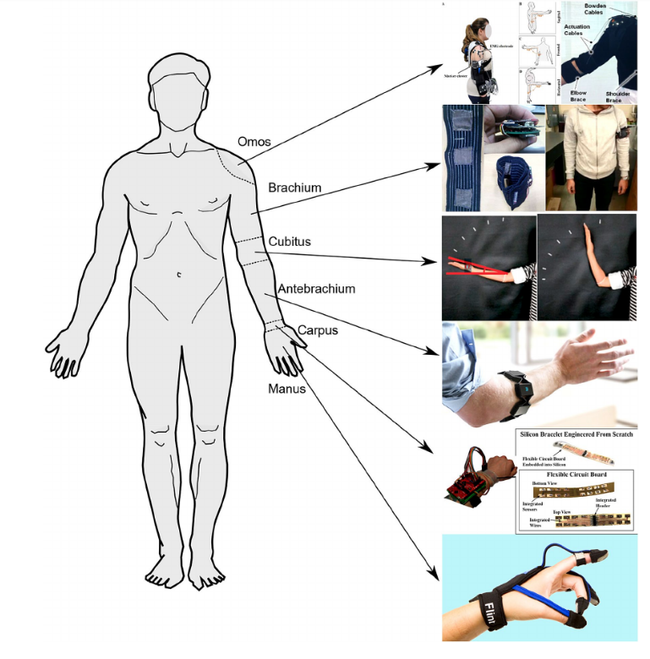


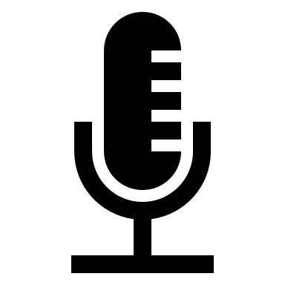


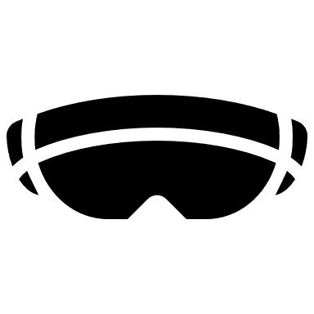
WEARABLE technology
Wearables make up a broad category that includes any device worn or attached to a user’s body. Smart watches, VR headsets and wearable electrocardiograms are a few examples. These devices support purposes related to areas like health and fitness, entertainment and everyday use.
Examples of Wearable Technologies
Health and Fitness Wearables
Life Insurance Wearables
Gaming Wearables
Fashion Wearables
Travel Wearables
Education Wearables

Slide 3
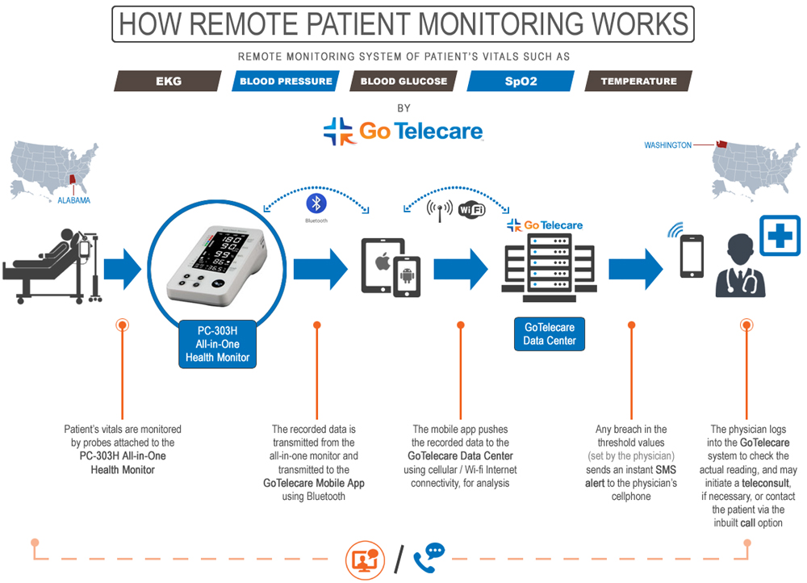
Notes:
Patient's vitals are monitored by probes attached to the PC-303H All-in-One Health Monitor. The recorded data is transmitted from the all-in-one monitor and transmitted to the GoTelecare Mobile App using Bluetooth. The mobile app pushes the recorded data to the GoTelecare Data Center using cellular / Wi-fi Internet connectivity, for analysis. Any breach in the threshold values (set by the physician) sends an instant SMS alert to the physician's cellphone. The physician logs into the GoTelecare system to check the actual reading, and may initiate a teleconsult,
if necessary, or contact the patient via the inbuilt call option.
Remote patient monitoring (RPM) uses technology to monitor patients' health outside of traditional clinical settings, such as hospitals or clinics. It allows healthcare providers to track patients' vital signs, symptoms, and other health data remotely, enabling proactive intervention and improved care management.
Here's how remote patient monitoring typically works:
Data Collection: Patients use wearable sensors, connected devices, or other remote monitoring tools to collect physiological data or report symptoms. This data can include:
Vital signs: Heart rate, blood pressure, blood glucose, oxygen saturation (SpO2), respiratory rate, temperature.
Activity levels: Steps taken, distance traveled, sleep patterns.
Weight: Body weight measurements.
ECG data: Heart rhythm information.
Patient-reported outcomes (PROs): Symptoms, pain levels, mood.
Data Transmission: The collected data is transmitted wirelessly (e.g., via Bluetooth, Wi-Fi, or cellular networks) to a secure platform or data center.
Data Storage and Processing: The platform stores the data and uses algorithms or analytics to process it. This can involve:
Data aggregation: Combining data from multiple sources.
Trend analysis: Identifying patterns and changes in the data over time.
Alert generation: Triggering alerts when data falls outside predefined thresholds or indicates a potential problem.
Remote Monitoring and Review: Healthcare providers access the data through a web-based portal or mobile app. They can:
View patient data: Review vital signs, trends, and other information.
Receive alerts: Be notified of concerning changes in patient data.
Communicate with patients: Use secure messaging, video calls, or other communication tools to interact with patients.
Adjust treatment plans: Modify medications, provide guidance, or schedule follow-up appointments based on the data.
Intervention and Care Management: Based on the monitored data, healthcare providers can intervene as needed. This can include:
Providing remote support and education: Offering guidance to patients on managing their condition.
Adjusting medications or treatment plans: Making changes based on the data.
Scheduling in-person or telehealth appointments: Bringing patients in for further evaluation or treatment if necessary.
Preventing hospital readmissions: Proactive monitoring can help identify and address potential problems before they escalate and require hospitalization.
Salient Features of Remote Patient Monitoring:
Continuous or Frequent Monitoring: Enables more frequent or continuous monitoring of patients' health compared to traditional in-person visits.
Proactive Care: Allows for early detection of changes in a patient's condition, enabling proactive intervention and preventing complications.
Improved Patient Outcomes: Can lead to better management of chronic conditions, reduced hospital readmissions, and improved overall health outcomes.
Enhanced Patient Engagement: Empowers patients to take a more active role in their own care.
Increased Efficiency for Healthcare Providers: Can reduce the need for frequent in-person visits, freeing up time for other tasks.
Cost-Effectiveness: Can help reduce healthcare costs by preventing hospital readmissions and improving efficiency.
Remote Access to Care: Enables access to care for patients in remote or underserved areas.
Personalized Care: Allows for more personalized care based on individual patient data.
Key Applications of RPM:
Chronic disease management: Heart failure, COPD, diabetes, hypertension.
Post-acute care: Monitoring patients after hospital discharge.
Home healthcare: Providing care for patients in their homes.
Clinical trials: Collecting data for research studies.
Remote patient monitoring is transforming healthcare by enabling more proactive, efficient, and patient-centered care. As technology continues to advance, RPM is expected to play an increasingly important role in improving health outcomes and reducing healthcare costs.

Slide 4

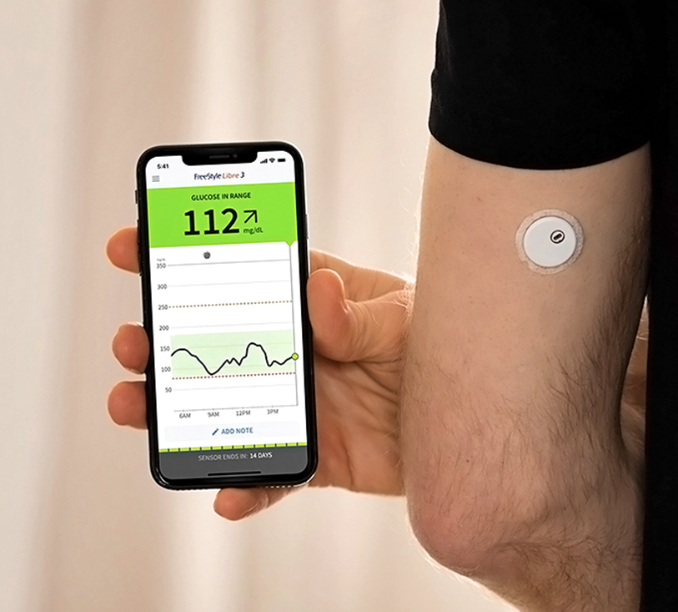
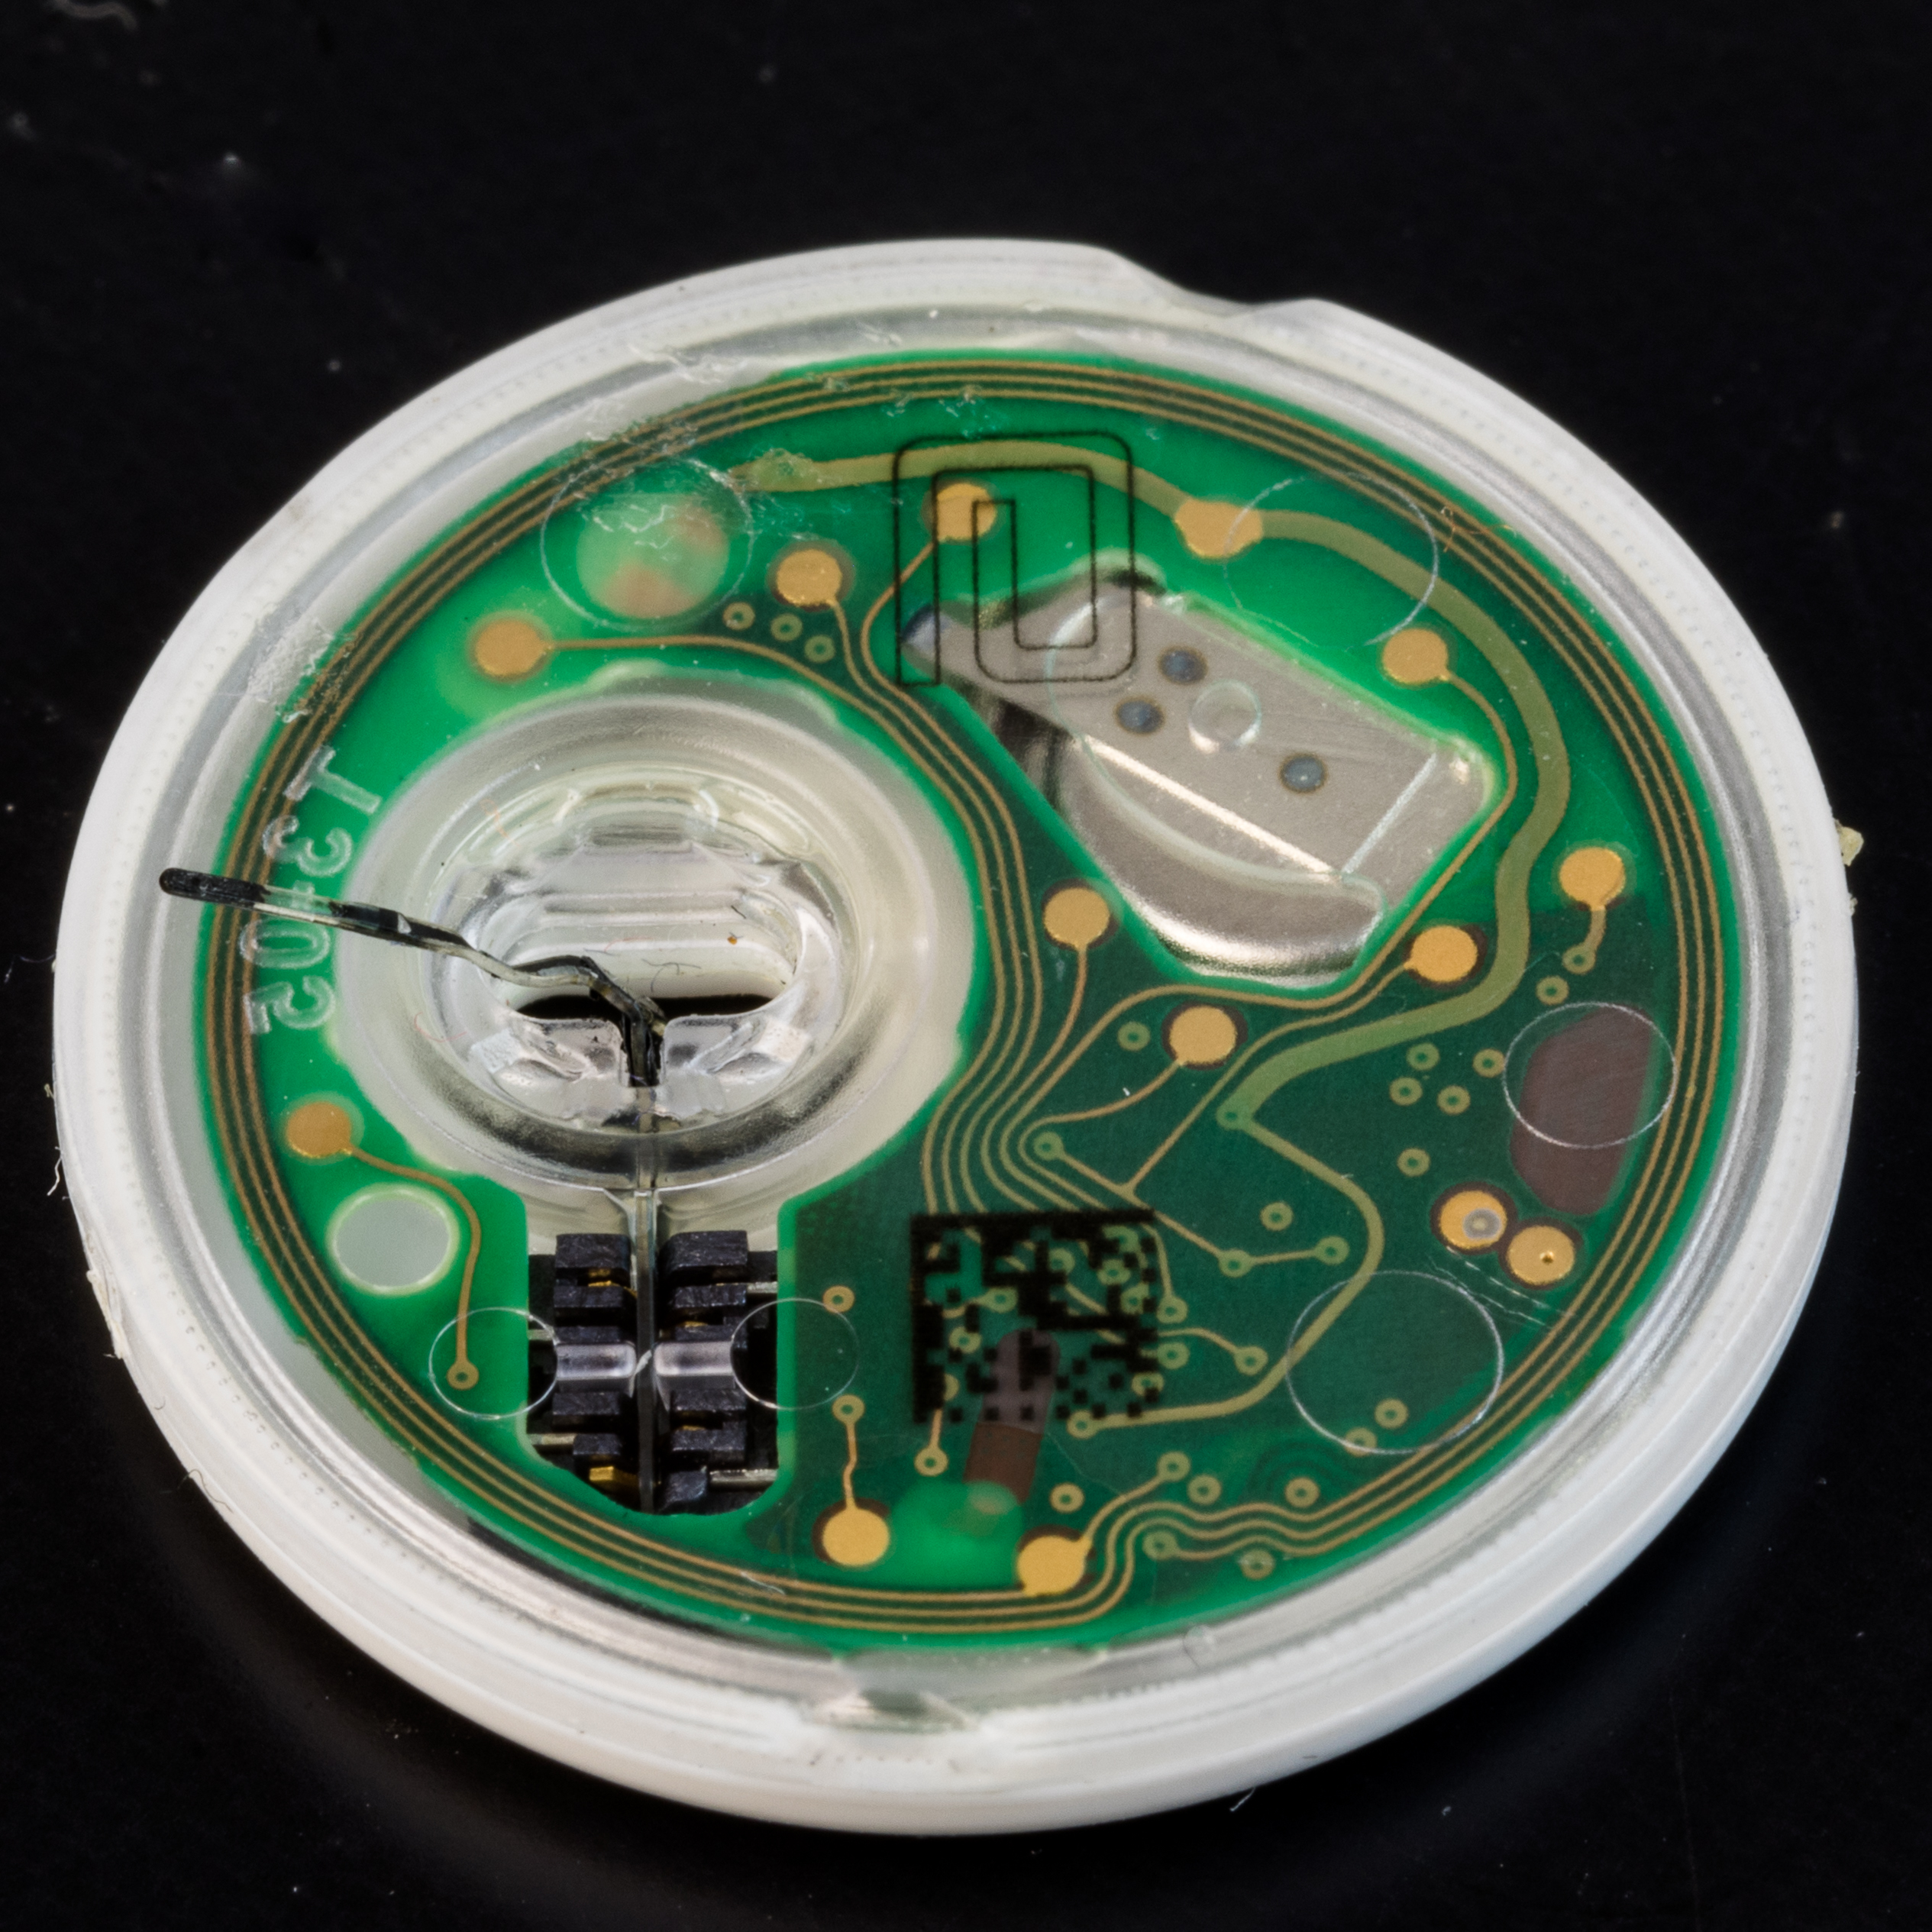
Medical Grade Wearables
Abbott FreeStyle Libre 3: Latest CGM tech
The Abbott FreeStyle Libre 3 is a continuous glucose monitoring (CGM) system designed for people with diabetes. It's the latest generation in the FreeStyle Libre line, known for its ease of use and affordability compared to some other CGM systems.
Key Advantages of CGM (in general, applicable to Libre 3):
Better Glucose Control:
Reduced Risk of Hypoglycemia.
Improved Time in Range.
Data for Trend Analysis.
Notes:
The Abbott FreeStyle Libre 3 is a continuous glucose monitoring (CGM) system designed for people with diabetes.¹ It's the latest generation in the FreeStyle Libre line, known for its ease of use and affordability compared to some other CGM systems.²
What is CGM?
Before diving into the Libre 3, let's clarify what CGM is:
Continuous Glucose Monitoring (CGM): A system that tracks glucose levels in real-time throughout the day and night.³ A small sensor inserted under the skin measures glucose in the interstitial fluid (the fluid between cells).⁴ The sensor transmits readings wirelessly to a receiver (a dedicated device or a smartphone app).⁵
Abbott FreeStyle Libre 3:
Salient Features
The FreeStyle Libre 3 builds upon previous versions with key improvements:⁶
Smallest and Thinnest Sensor: Abbott claims it's the smallest and thinnest CGM sensor available.⁷ This makes it more discreet and comfortable to wear.
Real-Time Glucose Readings: Unlike earlier FreeStyle Libre systems that required scanning the sensor to get a reading, the Libre 3 automatically sends glucose readings to a compatible smartphone every minute.⁸ This provides continuous glucose monitoring without the need for scanning.⁹
Optional Alarms: The system offers customizable alarms to alert users when their glucose levels are too high or too low.¹⁰ This feature helps prevent potentially dangerous hypo- or hyperglycemia.
14-Day Wear: The sensor can be worn for up to 14 days, reducing the frequency of sensor changes.¹¹
Accuracy: The FreeStyle Libre systems have generally been known for their accuracy, and the Libre 3 continues this trend.¹²
Smartphone App: The FreeStyle Libre 3 works with a dedicated smartphone app (FreeStyle Libre 3 app) that displays glucose readings, trends, and other data.¹³
Affordability: Abbott has focused on making the FreeStyle Libre systems more affordable than some other CGM systems, which has contributed to their popularity.¹⁴
Key Advantages of CGM (in general, applicable to Libre 3):
Better Glucose Control: Continuous monitoring helps people with diabetes understand how their glucose levels respond to food, exercise, and other factors, enabling them to make more informed decisions about their diabetes management.¹⁵
Reduced Risk of Hypoglycemia: Real-time alerts can help prevent dangerous low blood sugar events.¹⁶
Improved Time in Range: CGM helps users stay within their target glucose range for longer periods, which is associated with better long-term health outcomes.
Data for Trend Analysis: The system stores glucose data that can be reviewed with healthcare providers to adjust treatment plans.¹⁷
In summary: The Abbott FreeStyle Libre 3 is a significant advancement in CGM technology, offering a smaller, more convenient, and more informative way for people with diabetes to manage their glucose levels.¹⁸ Its key features include real-time readings, optional alarms, a long wear time, and a user-friendly smartphone app.

Slide 5
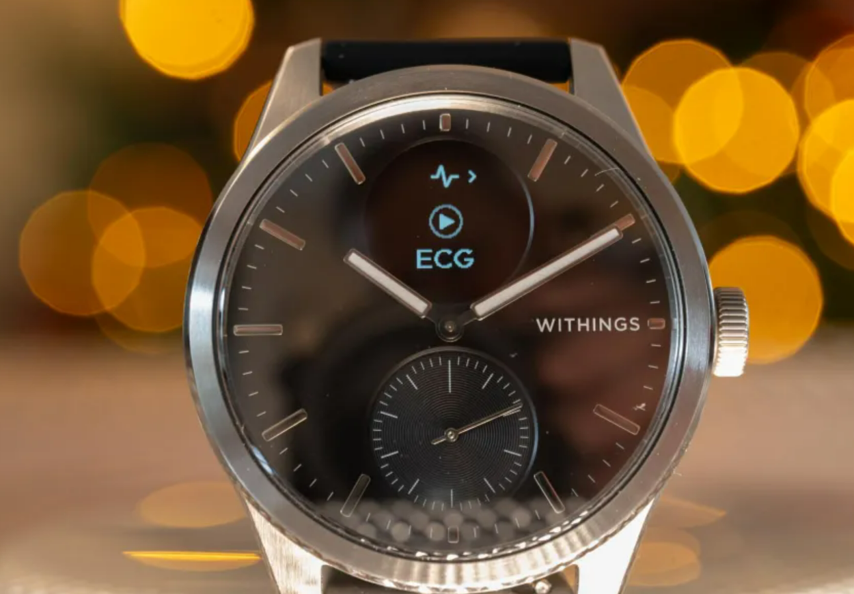
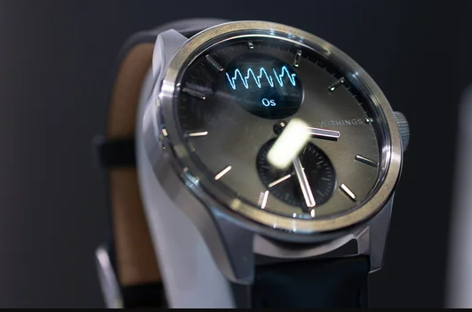
Medical Grade Wearables
The Withings ScanWatch 2
The Withings ScanWatch 2 is a hybrid smartwatch that combines traditional watch aesthetics with advanced health monitoring features. It's designed to provide users with continuous health data and insights, going beyond basic fitness tracking to offer clinically validated measurements.
Salient Features:
ECG (Electrocardiogram).
SpO2 (Blood Oxygen Saturation).
Heart Rate Monitoring.
Sleep Tracking.
Temperature Tracking.
Activity Tracking.
Long Battery Life.
Hybrid Design.
Withings App.
Key Advantages:
Proactive Health Monitoring
Clinically Validated Features.
Long Battery Life.
Discreet Design
Notes:
The Withings ScanWatch 2 is a hybrid smartwatch that combines traditional watch aesthetics with advanced health monitoring features.¹ It's designed to provide users with continuous health data and insights, going beyond basic fitness tracking to offer clinically validated measurements.²
"Medical monitoring" aspect:
The ScanWatch 2 aims to bridge the gap between consumer wearables and medical-grade devices. It offers features that have been clinically validated to some extent, allowing users to track important health metrics and potentially detect early signs of certain conditions.³
Salient Features:
ECG (Electrocardiogram): Can record an ECG on demand to detect signs of atrial fibrillation (AFib), a common heart rhythm disorder.⁴ This feature has received FDA clearance in the US and CE marking in Europe.⁵
SpO2 (Blood Oxygen Saturation): Measures blood oxygen levels, which can be useful for monitoring respiratory health and detecting potential issues like sleep apnea.⁶
Heart Rate Monitoring: Continuously tracks heart rate throughout the day and during workouts.⁷
Sleep Tracking: Provides detailed sleep analysis, including sleep stages (deep, light, REM) and sleep duration.⁸ It can also detect potential sleep disturbances.⁹
Temperature Tracking: The ScanWatch 2 introduces a new TempTech24/7 module that provides continuous body temperature monitoring, allowing users to track baseline temperature and detect potential deviations that could indicate illness.¹⁰
Activity Tracking: Tracks steps, distance, calories burned, and various sports activities.¹¹
Long Battery Life: Offers up to 30 days of battery life on a single charge, which is a significant advantage compared to many other smartwatches.¹²
Hybrid Design: Combines a traditional analog watch face with a small PMOLED display that shows health data and notifications. This gives it a classic watch look while providing smart features.
Withings App: Syncs with the Withings Health Mate app, which provides a comprehensive overview of health data, trends, and insights.¹³
Key Advantages:
Proactive Health Monitoring: Enables users to take a more proactive approach to their health by tracking key metrics and potentially detecting early signs of health issues.¹⁴
Clinically Validated Features: Offers features like ECG and SpO2 monitoring that have been clinically validated, providing a higher level of accuracy and reliability compared to some other wearables.¹⁵
Long Battery Life: Reduces the need for frequent charging.¹⁶
Discreet Design: The hybrid design makes it look like a traditional watch, making it suitable for everyday wear.
It's important to note:
The ScanWatch 2 is not intended to diagnose or treat any medical condition. It's a tool for monitoring health metrics and providing insights that users can discuss with their healthcare providers.¹⁷
While the ECG and SpO2 features have been clinically validated, it's essential to consult with a doctor for any health concerns.
The Withings ScanWatch 2 is a unique wearable that combines style with advanced health monitoring capabilities. Its focus on medical-grade features and long battery life makes it a compelling option for those who prioritize health tracking and proactive wellness management.

Slide 6
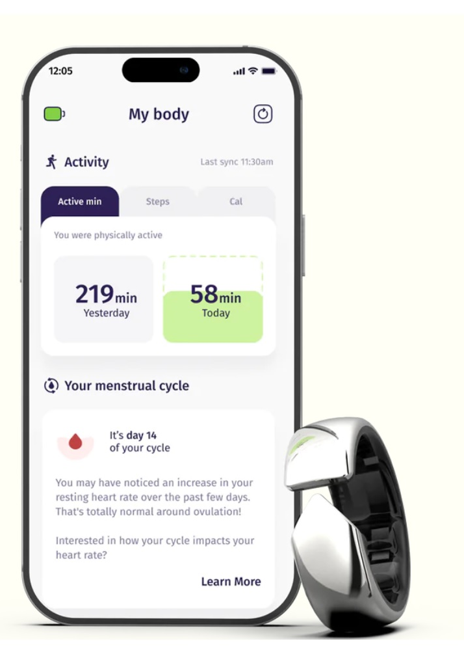
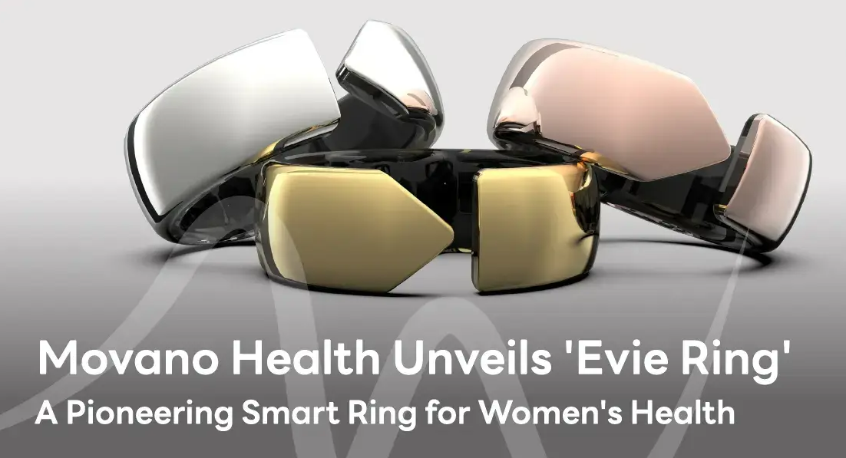
Medical Grade Wearables
The Movano Evie Ring
The Movano Evie Ring is a smart ring designed specifically for women's health, focusing on providing insights into overall wellness and offering features for managing health conditions. It's positioned as a more stylish and convenient alternative to traditional wearables like smartwatches or fitness trackers.
Salient Features:
Heart Rate and Heart Rate Variability (HRV).
Sleep Tracking.
Blood Oxygen Saturation (SpO2).
Menstrual Cycle Tracking.
Activity Tracking.
Mood Tracking.
Personalized Insights.
Stylish Design.
Low-Profile Form Factor.
Key Advantages:
Proactive Health Monitoring
Clinically Validated Features.
Long Battery Life.
Discreet Design
Notes:
The Movano Evie Ring is a smart ring designed specifically for women's health, focusing on providing insights into overall wellness and offering features for managing health conditions.¹ It's positioned as a more stylish and convenient alternative to traditional wearables like smartwatches or fitness trackers.
"Medical monitoring" aspect:
While not all features are FDA-cleared for diagnostic purposes (as of late 2023), Movano is pursuing FDA clearances for some of its health metrics, indicating an intention to move beyond general wellness tracking towards more clinically relevant measurements. This focus on validation differentiates it from many other smart rings on the market.
Salient Features:
Heart Rate and Heart Rate Variability (HRV): Tracks heart rate continuously and measures HRV, which is a key indicator of cardiovascular health and stress levels.²
Sleep Tracking: Monitors sleep stages (awake, light, deep, REM) and provides insights into sleep quality.³
Blood Oxygen Saturation (SpO2): Measures blood oxygen levels, which can be useful for monitoring respiratory health.⁴
Menstrual Cycle Tracking: Predicts and tracks menstrual cycles, providing insights into cycle patterns and potential irregularities.⁵ This is a core focus of the Evie Ring.
Activity Tracking: Tracks steps, calories burned, and active minutes, similar to other fitness trackers.⁶
Mood Tracking: Allows users to log their mood and identify potential correlations with other health metrics.⁷
Personalized Insights: The Evie app aims to provide personalized insights and recommendations based on the collected data.
Stylish Design: The ring is designed to be fashionable and comfortable for everyday wear. It comes in various sizes and finishes.⁸
Low-Profile Form Factor: Unlike larger smartwatches, the ring's small size makes it less obtrusive and more comfortable for some users, especially during sleep.
Key Advantages:
Focus on Women's Health: The Evie Ring is specifically designed to address women's health needs, particularly menstrual cycle tracking and related insights.⁹
Convenient Form Factor: The ring form factor is more discreet and comfortable for some users compared to other wearables.
Potential for Medical-Grade Measurements: Movano's pursuit of FDA clearances suggests a commitment to providing more clinically relevant data.¹⁰
Important Considerations:
FDA Clearance Status: It's crucial to check the current FDA clearance status of the Evie Ring's features. Not all features may be cleared for medical use in all regions.
Data Interpretation: While the app provides insights, it's essential to consult with a healthcare professional for diagnosis or treatment of any health concerns. The data provided by the ring should be used for informational purposes and in consultation with a doctor.
Battery Life: Like other smart rings, the Evie Ring requires regular charging, although specifics can vary.
The Movano Evie Ring is a unique wearable that caters specifically to women's health.¹¹ Its focus on personalized insights, stylish design, and potential for medical-grade measurements makes it a promising entry in the wearable health market. However, users should be aware of the current FDA clearance status of its features and consult with healthcare professionals for any health concerns.

Slide 7
Medical Grade Wearables
The Movano Evie Ring
The Movano Evie Ring is a smart ring designed specifically for women's health, focusing on providing insights into overall wellness and offering features for managing health conditions. It's positioned as a more stylish and convenient alternative to traditional wearables like smartwatches or fitness trackers.
Salient Features:
Heart Rate and Heart Rate Variability (HRV).
Sleep Tracking.
Blood Oxygen Saturation (SpO2).
Menstrual Cycle Tracking.
Activity Tracking.
Mood Tracking.
Personalized Insights.
Stylish Design.
Low-Profile Form Factor.
Feature | Abbott FreeStyle Libre 3 | Withings ScanWatch 2 | Movano Evie Ring
ECG | No | Yes (FDA cleared, CE marked) | No
PPG | No | Yes | Yes (pursuing FDA clearance for some metrics)
Primary Measurement | Glucose (CGM) | Heart rate, SpO2 (PPG), ECG | Heart rate, HRV, SpO2, more (PPG)
Accuracy Comparison | Not applicable (measures glucose) | ECG: Clinically validated. PPG: Likely internally validated, but less external validation than ECG. | PPG: Accuracy is dependent on pending FDA clearances.
Key Advantages:
Proactive Health Monitoring
Clinically Validated Features.
Long Battery Life.
Discreet Design
Notes:
The Movano Evie Ring is a smart ring designed specifically for women's health, focusing on providing insights into overall wellness and offering features for managing health conditions.¹ It's positioned as a more stylish and convenient alternative to traditional wearables like smartwatches or fitness trackers.
"Medical monitoring" aspect:
While not all features are FDA-cleared for diagnostic purposes (as of late 2023), Movano is pursuing FDA clearances for some of its health metrics, indicating an intention to move beyond general wellness tracking towards more clinically relevant measurements. This focus on validation differentiates it from many other smart rings on the market.
Salient Features:
Heart Rate and Heart Rate Variability (HRV): Tracks heart rate continuously and measures HRV, which is a key indicator of cardiovascular health and stress levels.²
Sleep Tracking: Monitors sleep stages (awake, light, deep, REM) and provides insights into sleep quality.³
Blood Oxygen Saturation (SpO2): Measures blood oxygen levels, which can be useful for monitoring respiratory health.⁴
Menstrual Cycle Tracking: Predicts and tracks menstrual cycles, providing insights into cycle patterns and potential irregularities.⁵ This is a core focus of the Evie Ring.
Activity Tracking: Tracks steps, calories burned, and active minutes, similar to other fitness trackers.⁶
Mood Tracking: Allows users to log their mood and identify potential correlations with other health metrics.⁷
Personalized Insights: The Evie app aims to provide personalized insights and recommendations based on the collected data.
Stylish Design: The ring is designed to be fashionable and comfortable for everyday wear. It comes in various sizes and finishes.⁸
Low-Profile Form Factor: Unlike larger smartwatches, the ring's small size makes it less obtrusive and more comfortable for some users, especially during sleep.
Key Advantages:
Focus on Women's Health: The Evie Ring is specifically designed to address women's health needs, particularly menstrual cycle tracking and related insights.⁹
Convenient Form Factor: The ring form factor is more discreet and comfortable for some users compared to other wearables.
Potential for Medical-Grade Measurements: Movano's pursuit of FDA clearances suggests a commitment to providing more clinically relevant data.¹⁰
Important Considerations:
FDA Clearance Status: It's crucial to check the current FDA clearance status of the Evie Ring's features. Not all features may be cleared for medical use in all regions.
Data Interpretation: While the app provides insights, it's essential to consult with a healthcare professional for diagnosis or treatment of any health concerns. The data provided by the ring should be used for informational purposes and in consultation with a doctor.
Battery Life: Like other smart rings, the Evie Ring requires regular charging, although specifics can vary.
The Movano Evie Ring is a unique wearable that caters specifically to women's health.¹¹ Its focus on personalized insights, stylish design, and potential for medical-grade measurements makes it a promising entry in the wearable health market. However, users should be aware of the current FDA clearance status of its features and consult with healthcare professionals for any health concerns.

Slide 8

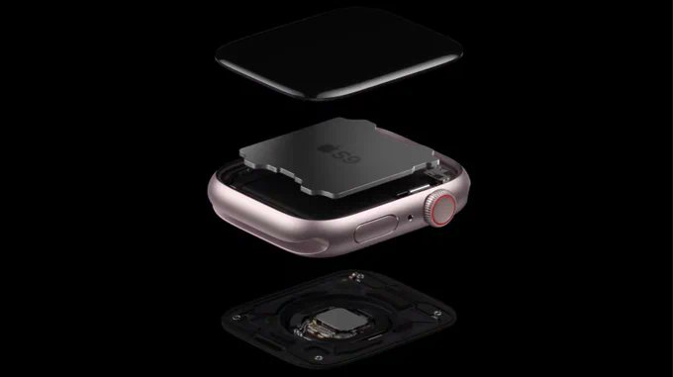
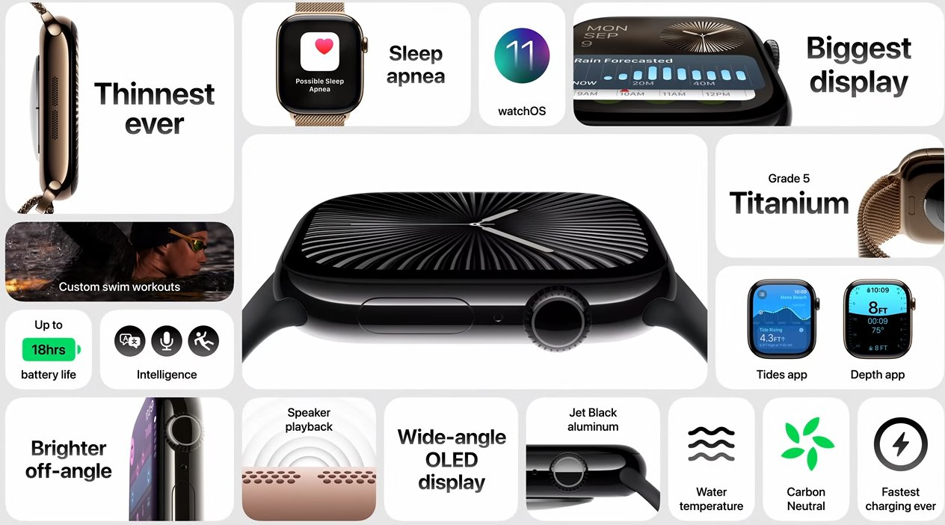
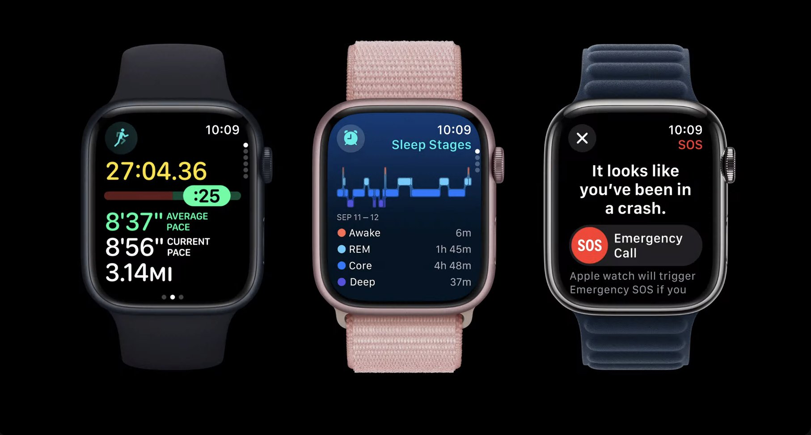
Consumer Health Tech
The Apple Watch Series 9:
The apple watch series 9 is the latest iteration of apple's popular smartwatch, focusing on enhanced performance, new features, and continued emphasis on health and fitness tracking.
Salient features:
s9 sip (system in package).
Double tap gesture.
Brighter display.
Health and fitness tracking:
ecg.
Blood oxygen (spo2).
Heart rate monitoring.
Cycle tracking.
Sleep stages.
Activity tracking.
Temperature sensing.
Key Advantages:
Comprehensive Health Monitoring.
Advanced Technology.
Safety Features.
Notes:
The Apple Watch Series 9 is the latest iteration of Apple's popular smartwatch, focusing on enhanced performance, new features, and continued emphasis on health and fitness tracking.¹
Salient Features:
S9 SiP (System in Package): This new chip provides significant performance improvements, including faster processing and enhanced on-device Siri capabilities.² This allows for faster app launching, smoother animations, and more responsive interactions.
Double Tap Gesture: A new way to interact with the watch without touching the screen.³ By tapping your thumb and index finger together twice, you can answer calls, end calls, stop timers, and perform other actions.
Brighter Display: The Always-On Retina display now boasts up to 2,000 nits of peak brightness, making it easier to see in direct sunlight.⁴
Health and Fitness Tracking:
ECG (Electrocardiogram): Can record an ECG similar to a single-lead electrocardiogram to detect signs of atrial fibrillation (AFib).⁵
Blood Oxygen (SpO2): Measures blood oxygen saturation levels.⁶
Heart Rate Monitoring: Continuously tracks heart rate and provides notifications for unusually high or low heart rates.⁷
Cycle Tracking: Allows women to track their menstrual cycles and receive ovulation estimates.⁸
Sleep Stages: Provides detailed sleep tracking, including time spent in different sleep stages (REM, Core, Deep).⁹
Activity Tracking: Tracks steps, calories burned, workouts, and other fitness metrics.¹⁰
Temperature Sensing: The watch has two temperature sensors — one on the back crystal near your wrist and another under the display — to reduce outside bias. This enables features like cycle tracking with retrospective ovulation estimates and temperature sensing during sleep.¹¹
Safety Features:
Fall Detection: Can detect hard falls and automatically call emergency services if the user is unresponsive.¹²
Emergency SOS: Allows users to quickly call for help in an emergency.¹³
Crash Detection: Can detect severe car crashes and automatically contact emergency services.¹⁴
watchOS 10: The latest version of Apple's watch operating system brings new features and improvements to the user interface, including redesigned apps, new watch faces, and enhanced navigation.¹⁵
Connectivity: Available in GPS and GPS + Cellular models.¹⁶ Cellular models allow for calls, texts, and data usage without an iPhone nearby.¹⁷
Durability: Features a durable design with a crack-resistant front crystal and water resistance up to 50 meters.¹⁸
Key Advantages:
Comprehensive Health Monitoring: Offers a wide range of health and fitness tracking features.¹⁹
Advanced Technology: Incorporates the latest hardware and software advancements for improved performance and user experience.²⁰
Seamless Integration with Apple Ecosystem: Works seamlessly with other Apple devices and services.
Safety Features: Provides valuable safety features for peace of mind.
Important Note:
Like other wearables with health monitoring features, the Apple Watch Series 9 is not intended to diagnose or treat any medical condition. It's a tool for tracking health metrics and providing insights that users can discuss with their healthcare providers.²¹
The Apple Watch Series 9 is a powerful and versatile smartwatch that offers a compelling combination of health and fitness tracking, advanced technology, and seamless integration with the Apple ecosystem.²²

Slide 9
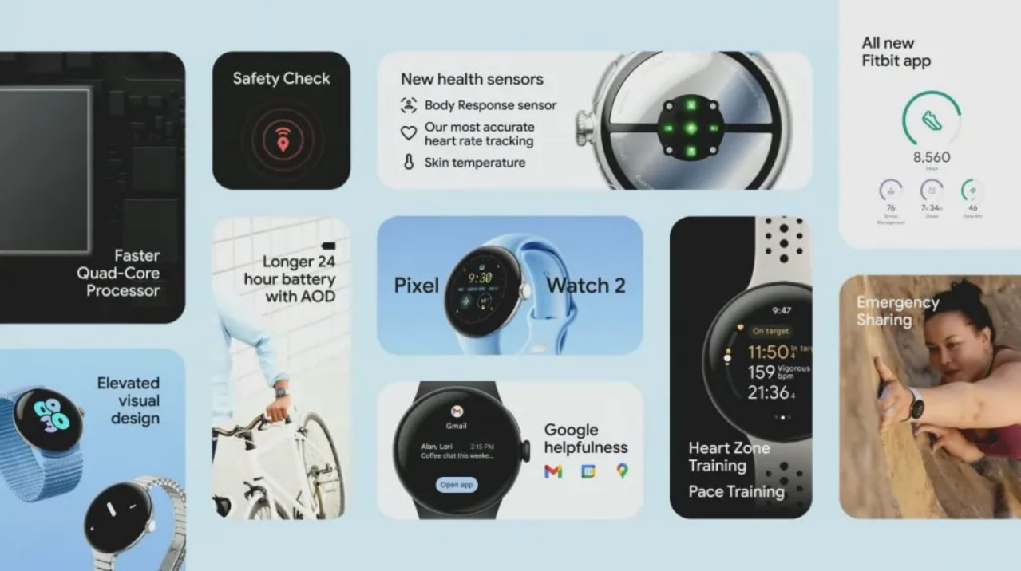
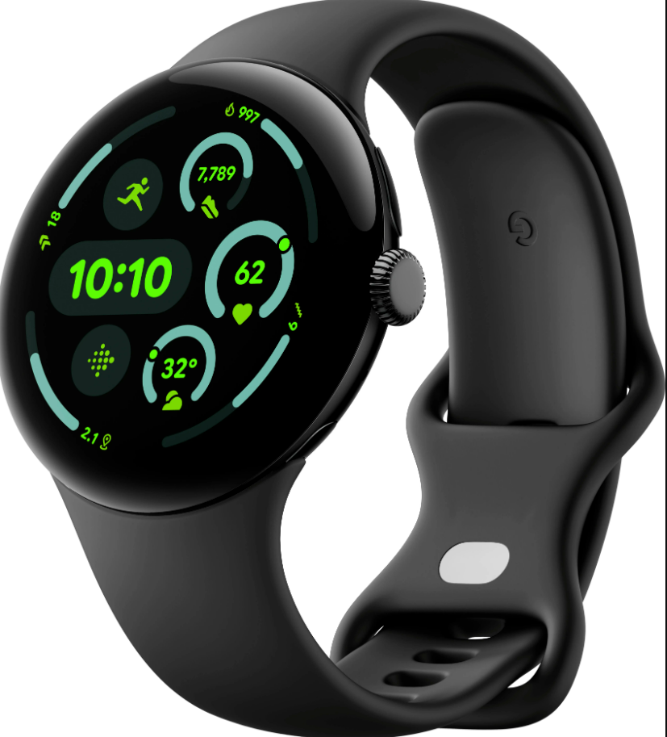
Consumer Health Tech
The Google Pixel Watch 2 is Google's second-generation smartwatch, designed to integrate seamlessly with the Android ecosystem and provide a comprehensive wearable experience. It builds upon the first Pixel Watch with improvements in performance, health tracking, and design
Salient features:
Improved Performance:
Enhanced Health Tracking (Powered by Fitbit):
Heart Rate Tracking.
Activity Tracking.
Sleep Tracking.
Body Response Tracking (cEDA).
Blood Oxygen (SpO2) Monitoring.
Safety Check.
Fall Detection.
ECG App.
Improved Design and Comfort.
Wear OS by Google.
Seamless Android Integration.
Fast Pair.

Slide 10
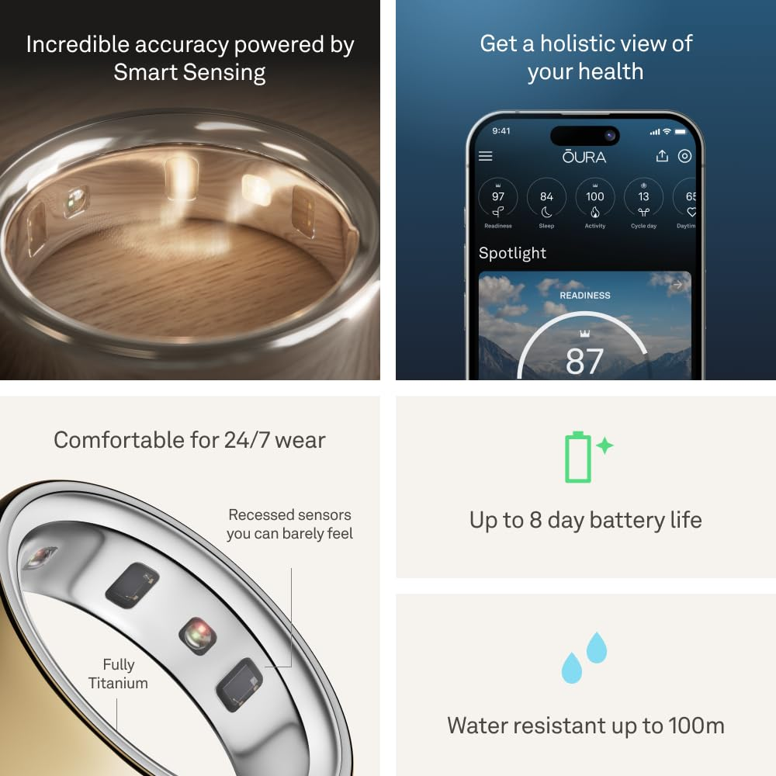
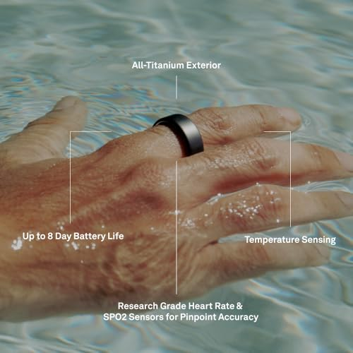
Consumer Health Tech
The Oura Ring Gen 3 is a wearable health tracker in the form of a ring. It focuses primarily on sleep tracking, recovery, and overall wellness, using various sensors to gather data about the wearer's body. Unlike smartwatches with screens, the Oura Ring is designed to be worn continuously, providing passive monitoring.
Salient features:
Advanced Sleep Tracking.
Activity Tracking.
Readiness Score.
Heart Rate and HRV Monitoring.
Body Temperature Sensing.
Period Prediction.
Guided Content.
Comfortable and Discreet Design.
Long Battery Life.
Key Advantages:
Detailed Sleep Analysis: Provides much more in-depth sleep data than many other wearables.
Focus on Recovery and Wellness: Emphasizes the importance of rest and recovery.
Non-intrusive Form Factor: The ring is less obtrusive than a smartwatch.
Notes:
The Oura Ring Gen 3 is a wearable health tracker in the form of a ring.¹ It focuses primarily on sleep tracking, recovery, and overall wellness, using various sensors to gather data about the wearer's body.² Unlike smartwatches with screens, the Oura Ring is designed to be worn continuously, providing passive monitoring.
Elaboration on Sleep Analysis Feature:
The Oura Ring's sleep tracking is one of its most prominent features.³ It goes beyond simply measuring sleep duration and provides a detailed breakdown of sleep stages:⁴
Sleep Stages: The ring differentiates between Awake, REM (Rapid Eye Movement), Light, and Deep sleep stages.⁵ This allows users to understand the quality of their sleep and identify potential disruptions.⁶
Sleep Score: Oura provides a Sleep Score based on various factors, including total sleep time, sleep efficiency (time spent asleep vs. time in bed), latency (time it takes to fall asleep), number of awakenings, REM sleep duration, and deep sleep duration.⁷
Resting Heart Rate (RHR) and Heart Rate Variability (HRV) during Sleep: The ring monitors RHR and HRV throughout the night.⁸ Changes in these metrics can provide insights into recovery, stress levels, and overall health.⁹
Body Temperature during Sleep: The Oura Ring tracks changes in body temperature during sleep, which can be useful for identifying potential illness or tracking menstrual cycles.¹⁰
Sleep Timing and Consistency: The ring tracks sleep and wake times to provide insights into sleep consistency and circadian rhythm.¹¹
Salient Features of the Oura Ring Gen 3:
Advanced Sleep Tracking: As described above, this is a core feature.
Activity Tracking: Tracks steps, calories burned, and activity levels.¹² However, it's not designed for real-time workout tracking like some fitness trackers.¹³ Its focus is more on overall daily activity.
Readiness Score: This score combines sleep data, activity data, and other physiological metrics to provide a daily assessment of how ready the body is for physical and mental exertion.¹⁴
Heart Rate and HRV Monitoring: Measures heart rate and HRV throughout the day and night.¹⁵
Body Temperature Sensing: Tracks changes in body temperature.¹⁶
Period Prediction: Uses temperature data and other metrics to predict menstrual cycles.¹⁷
Guided Content: The Oura app provides personalized insights, recommendations, and guided audio sessions for sleep, meditation, and other wellness practices.¹⁸
Comfortable and Discreet Design: The ring is designed to be comfortable for 24/7 wear.¹⁹
Long Battery Life: Typically lasts for several days on a single charge.²⁰
Key Advantages:
Detailed Sleep Analysis: Provides much more in-depth sleep data than many other wearables.²¹
Focus on Recovery and Wellness: Emphasizes the importance of rest and recovery.²²
Non-intrusive Form Factor: The ring is less obtrusive than a smartwatch.
Important Considerations:
No Display: The Oura Ring does not have a screen, so all data is viewed through the mobile app.²³
Subscription Model: Some features, like personalized insights and guided content, require an Oura Membership subscription.²⁴
Not Designed for Real-Time Workout Tracking: While it tracks activity, it's not ideal for monitoring workouts in real-time.²⁵
The Oura Ring Gen 3 is a unique wearable that excels in sleep tracking and providing insights into overall wellness. Its focus on passive monitoring and non-intrusive design makes it a popular choice for those who prioritize sleep and recovery.

Slide 11
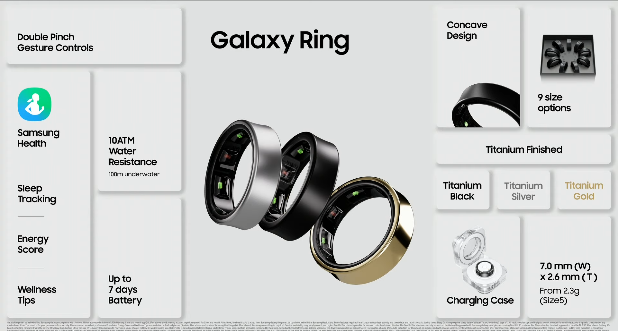
Consumer Health Tech
Samsung Galaxy Ring, announced in 2024, is Samsung's entry into the smart ring market, focusing on health and wellness tracking in a discreet and convenient form factor. It aims to compete with established players like Oura and offer a compelling alternative to smartwatches. .
Salient features:
Health Tracking.
Heart Rate Monitoring.
Blood Oxygen (SpO2) Monitoring.
Sleep Tracking:
Skin Temperature Sensing.
Activity Tracking.
AI-Powered Insights.
Seamless Integration with Samsung Ecosystem.
Discreet and Comfortable Design.
Long Battery Life.
Gesture Control.
Key Advantages:
Comprehensive health monitoring in a small form factor.
Ai-powered personalization.
Seamless samsung ecosystem integration.
Long battery life
Notes:
The Samsung Galaxy Ring, announced in 2024, is Samsung's entry into the smart ring market, focusing on health and wellness tracking in a discreet and convenient form factor.¹ It aims to compete with established players like Oura and offer a compelling alternative to smartwatches.
Salient Features:
Health Tracking:
Heart Rate Monitoring: Tracks heart rate using an optical bio-signal sensor.²
Blood Oxygen (SpO2) Monitoring: Measures blood oxygen saturation levels.³
Sleep Tracking: Monitors sleep stages (likely using accelerometer data and heart rate variability) to provide insights into sleep quality.⁴
Skin Temperature Sensing: Tracks skin temperature changes, which can be useful for various purposes, including cycle tracking and identifying potential signs of illness.⁵
Activity Tracking: Uses an accelerometer to track steps, distance, and other basic activity metrics.⁶ It can also automatically detect and track workouts like walking and running.⁷
AI-Powered Insights: The Galaxy Ring integrates with the Samsung Health app and leverages AI to provide personalized insights and recommendations based on the collected data.⁸ This includes an "Energy Score" that combines sleep, activity, and recovery data to give users a daily assessment of their overall well-being.⁹
Seamless Integration with Samsung Ecosystem: Designed to work seamlessly with Samsung Galaxy smartphones and other Samsung devices.¹⁰
Discreet and Comfortable Design: The ring form factor is designed to be comfortable for 24/7 wear and less obtrusive than a smartwatch.¹¹
Long Battery Life: Offers up to 7 days of battery life on a single charge.¹²
Gesture Control: The Galaxy Ring supports gestures that can be used to control other devices or perform actions, such as dismissing alarms or taking photos.¹³
Key Advantages:
Comprehensive Health Monitoring in a Small Form Factor: Provides a wide range of health and fitness tracking features in a discreet and comfortable ring form factor.¹⁴
AI-Powered Personalization: Leverages AI to provide personalized insights and recommendations.¹⁵
Seamless Samsung Ecosystem Integration: Offers a smooth and integrated experience for Samsung users.¹⁶
Long Battery Life: Reduces the need for frequent charging.¹⁷
Important Considerations:
Limited Ecosystem: The Galaxy Ring is primarily designed for use within the Samsung ecosystem, so its functionality may be limited for users with non-Samsung devices.
New Product Category: As a relatively new product category for Samsung, it remains to be seen how the Galaxy Ring will perform in real-world use and how its features will evolve over time.
The Samsung Galaxy Ring is a promising new wearable that offers a compelling combination of health tracking, AI-powered insights, and a discreet design. Its strong integration with the Samsung ecosystem and focus on user experience make it a noteworthy competitor in the smart ring market.

Slide 12
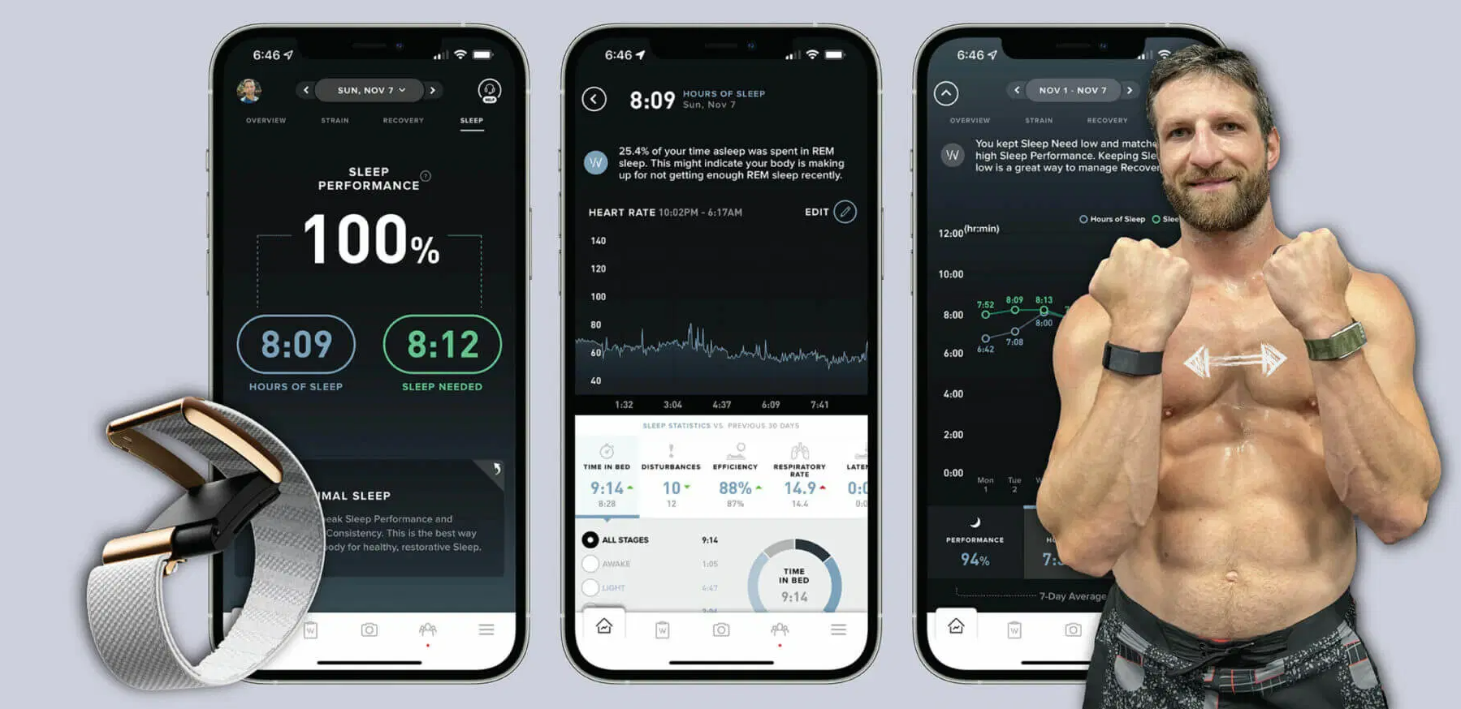
Consumer Health Tech
The Whoop 4.0, is a wearable health and fitness tracker that distinguishes itself by focusing on recovery, sleep optimization, and performance analysis. It's designed for athletes and individuals who are serious about tracking and improving their overall fitness and well-being. Unlike traditional smartwatches, Whoop doesn't have a screen; it's a sensor-packed band that relays data to a mobile app.
Salient features:
Strain.
Recovery.
Sleep Tracking.
Heart Rate Variability (HRV) Monitoring.
Resting Heart Rate (RHR) Monitoring.
Blood Oxygen Monitoring.
Skin Temperature Monitoring.
Workout Detection and Classification.
Journal.
Whoop Membership.
Key Advantages:
Focus on Recovery and Performance.
Detailed Sleep Analysis.
Actionable Insights.
Community Features.
Notes:
The Whoop 4.0 is a wearable health and fitness tracker that distinguishes itself by focusing on recovery, sleep optimization, and performance analysis.¹ It's designed for athletes and individuals who are serious about tracking and improving their overall fitness and well-being.² Unlike traditional smartwatches, Whoop doesn't have a screen; it's a sensor-packed band that relays data to a mobile app.³
Salient Features:
Strain: Whoop's core metric is "Strain," which quantifies the cardiovascular load placed on your body during physical activity. It uses heart rate data to calculate Strain on a scale of 0-21, with higher scores indicating more strenuous activity.⁴
Recovery: Whoop emphasizes recovery as a crucial component of fitness. It uses metrics like heart rate variability (HRV), resting heart rate (RHR), and sleep to assess your body's recovery status.⁵ The "Recovery Score" indicates how prepared you are to take on Strain.⁶
Sleep Tracking: Whoop provides detailed sleep analysis, including sleep stages (Awake, Light, Deep, REM), sleep duration, sleep efficiency, and time in bed.⁷ It also offers personalized sleep coaching to help you optimize your sleep.⁸
Heart Rate Variability (HRV) Monitoring: Continuously monitors HRV, which is a key indicator of autonomic nervous system activity and overall health.⁹
Resting Heart Rate (RHR) Monitoring: Tracks RHR, which can be a useful indicator of fitness level and recovery.¹⁰
Blood Oxygen Monitoring: Tracks blood oxygen saturation (SpO2) levels.¹¹
Skin Temperature Monitoring: Tracks skin temperature, which can be useful for detecting potential illness or tracking menstrual cycles.¹²
Workout Detection and Classification: Automatically detects and classifies workouts, providing detailed performance data.¹³
Journal: Allows users to log various factors that can affect their health and recovery, such as sleep quality, stress levels, and dietary habits.¹⁴ This helps identify correlations between lifestyle choices and physiological metrics.
Whoop Membership: Whoop operates on a membership model, which includes access to the hardware (the band), the mobile app, and personalized insights and coaching.¹⁵
Key Advantages:
Focus on Recovery and Performance: Unlike many fitness trackers that primarily focus on activity tracking, Whoop places a strong emphasis on recovery and providing actionable insights to improve performance.¹⁶
Detailed Sleep Analysis: Provides very comprehensive sleep data and personalized sleep coaching.¹⁷
Actionable Insights: The app provides clear and concise interpretations of the data, helping users understand how their lifestyle choices affect their health and recovery.¹⁸
Community Features: Whoop offers community features that allow users to connect with other members and share their data.¹⁹
Important Considerations:
No Display: Whoop doesn't have a screen, so all data is viewed through the mobile app.²⁰
Membership Model: Requires a recurring membership fee.²¹
Not Designed for Casual Wear: Its focus is on fitness and performance, so it may not be the best choice for those looking for a stylish everyday smartwatch.
The Whoop 4.0 is a unique wearable that caters to serious athletes and individuals who are highly focused on optimizing their fitness and recovery.²² Its emphasis on Strain, Recovery, and detailed sleep analysis sets it apart from other wearables on the market.

Slide 13
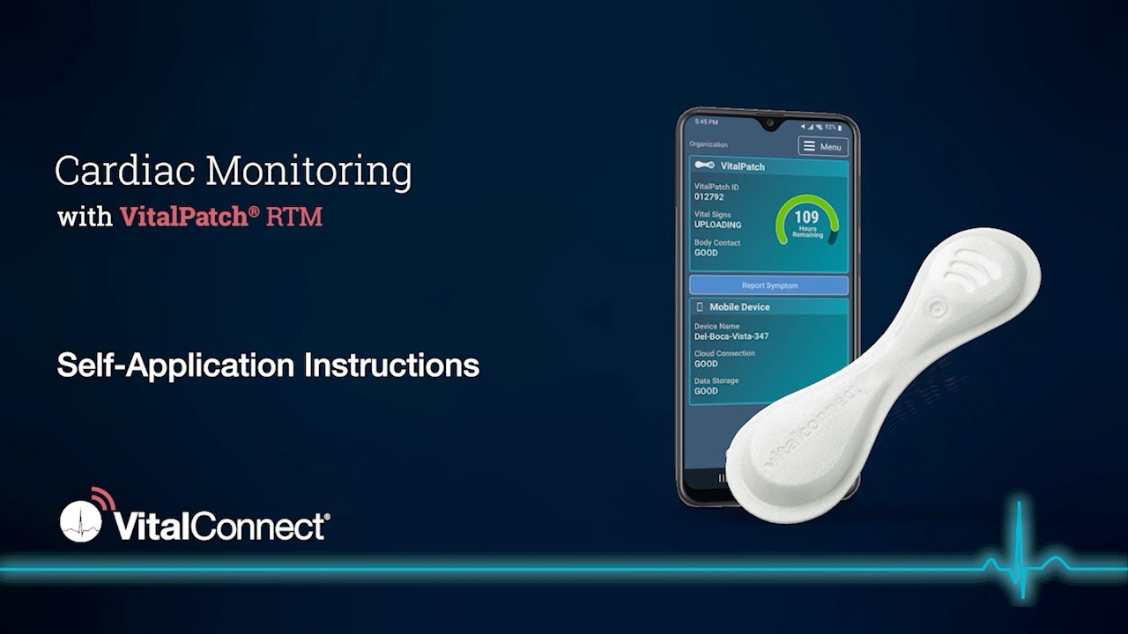
Consumer Health Tech
VitalConnect VitalPatch is a biosensor patch designed for continuous remote patient monitoring (RPM). It's a single-use, disposable patch that adheres to the chest and collects a variety of physiological data, transmitting it wirelessly to healthcare providers. It's primarily used in hospital settings, post-acute care, and clinical research rather than for consumer fitness tracking..
Salient features:
Continuous Monitoring.
Data Collected.
Heart Rate.
Heart Rate Variability (HRV).
Respiratory Rate.
Body Temperature.
Posture and Activity.
Wireless Data Transmission.
Remote Monitoring by Healthcare Providers.
Alerts and Notifications.
Single-Use and Disposable.
Water-Resistant.
Key Advantages:
Early Detection of Deterioration.
Reduced Hospital Readmissions.
Improved Patient Outcomes.
Increased Efficiency for Healthcare Providers.
Data for Clinical Research
Notes:
The VitalConnect VitalPatch is a biosensor patch designed for continuous remote patient monitoring (RPM).¹ It's a single-use, disposable patch that adheres to the chest and collects a variety of physiological data, transmitting it wirelessly to healthcare providers.² It's primarily used in hospital settings, post-acute care, and clinical research rather than for consumer fitness tracking.
Salient Features:
Continuous Monitoring: The VitalPatch continuously monitors vital signs, providing a comprehensive view of a patient's physiological status over time.³
Data Collected: The patch collects a range of data, including:
Single-Lead ECG: Provides continuous electrocardiogram monitoring for heart rhythm analysis.⁴
Heart Rate: Tracks heart rate continuously.⁵
Heart Rate Variability (HRV): Measures HRV, a key indicator of autonomic nervous system activity.
Respiratory Rate: Measures breathing rate.
Body Temperature: Tracks skin temperature.
Posture and Activity: Detects patient posture (e.g., lying, sitting, standing) and activity levels.⁶
Wireless Data Transmission: Data is transmitted wirelessly via Bluetooth to a smartphone, tablet, or gateway device, which then relays the data to a secure cloud platform.⁷
Remote Monitoring by Healthcare Providers: Healthcare providers can access the data remotely through a web-based portal or other integrated systems.⁸ This allows for continuous monitoring of patients' conditions, even outside of the hospital setting.⁹
Alerts and Notifications: The system can be configured to generate alerts for specific physiological thresholds, allowing for timely intervention by healthcare providers.
Single-Use and Disposable: The patch is designed for single-use and is disposed of after a set period (typically several days), reducing the risk of cross-contamination and simplifying logistics.¹⁰
Water-Resistant: Designed to withstand daily activities, including showering.
Key Advantages:
Early Detection of Deterioration: Continuous monitoring allows for early detection of changes in a patient's condition, potentially preventing serious adverse events.¹¹
Reduced Hospital Readmissions: By enabling remote monitoring after discharge, the VitalPatch can help reduce hospital readmissions.¹²
Improved Patient Outcomes: Continuous monitoring and timely intervention can lead to improved patient outcomes.¹³
Increased Efficiency for Healthcare Providers: Remote monitoring can reduce the need for frequent in-person check-ups, freeing up healthcare providers' time.¹⁴
Data for Clinical Research: The collected data can be used for clinical research and to develop new insights into various health conditions.¹⁵
Key Use Cases:
Post-Surgical Monitoring: Monitoring patients after surgery to detect complications early.
Chronic Disease Management: Monitoring patients with chronic conditions like heart failure or COPD.¹⁶
Remote Patient Monitoring in Clinical Trials: Collecting physiological data in clinical research studies.
Important Considerations:
Prescription Required: The VitalPatch is a medical device and typically requires a prescription from a healthcare provider.
Not a Consumer Device: It's not intended for general fitness tracking or consumer use.
The VitalConnect VitalPatch is a powerful tool for remote patient monitoring, offering continuous collection and transmission of vital signs data to healthcare providers.¹⁷ Its focus on clinical applications and its ability to detect early signs of deterioration make it a valuable asset in modern healthcare.

Slide 14
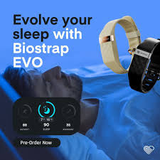
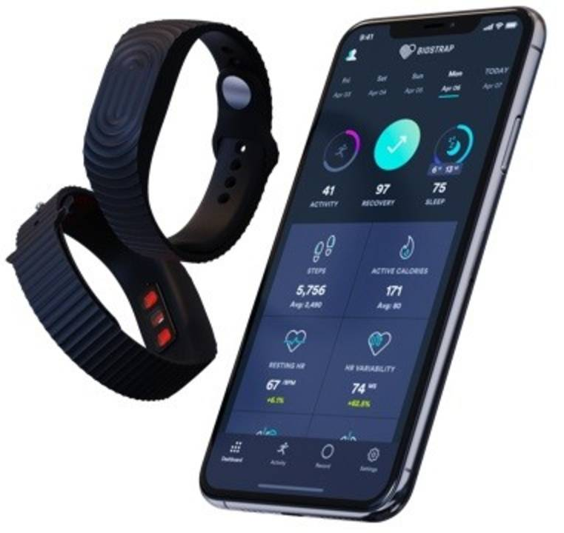
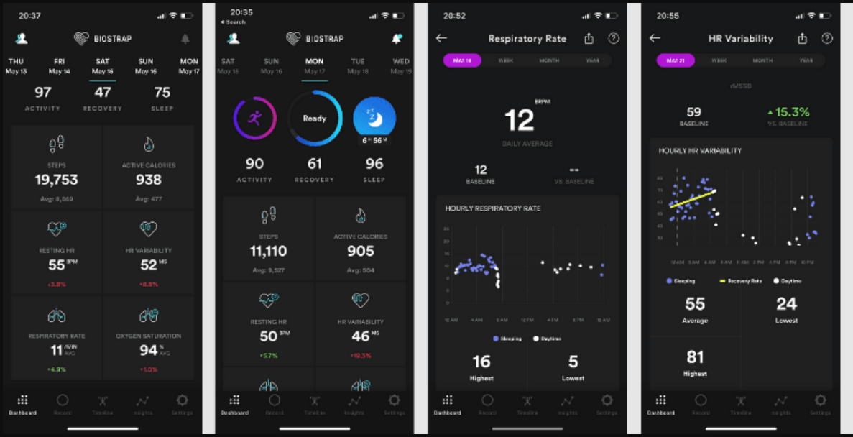
Consumer Health Tech
Biostrap EVO is a wearable health and fitness tracker that focuses on providing detailed physiological data and insights, particularly related to sleep, recovery, and performance. It differentiates itself through its use of multiple sensors and advanced analytics. Unlike some other wearables that focus primarily on activity tracking, Biostrap emphasizes a more holistic view of well-being.
Salient features:
Multi-Sensor Platform: Biostrap EVO uses a combination of sensors to gather data:
Photoplethysmography (PPG) Sensor.
3-Axis Accelerometer.
Gyroscopic Sensor.
Advanced Sleep Tracking: Biostrap offers detailed sleep analysis:
Sleep Stages.
Sleep Time and Efficiency.
Sleep Latency.
Sleep Fragmentation.
Recovery Monitoring.
Workout Tracking.
Heart Rate Variability (HRV) Analysis.
Blood Oxygen (SpO2) Monitoring.
Biostrap App.
Wristband and Shoe Pod Options.
Key Advantages:
Early Detection of Deterioration.
Reduced Hospital Readmissions.
Improved Patient Outcomes.
Increased Efficiency for Healthcare Providers.
Data for Clinical Research
Notes:
The Biostrap EVO is a wearable health and fitness tracker that focuses on providing detailed physiological data and insights, particularly related to sleep, recovery, and performance. It differentiates itself through its use of multiple sensors and advanced analytics. Unlike some other wearables that focus primarily on activity tracking, Biostrap emphasizes a more holistic view of well-being.
Salient Features:
Multi-Sensor Platform: Biostrap EVO uses a combination of sensors to gather data:
Photoplethysmography (PPG) Sensor: Measures heart rate, heart rate variability (HRV), and blood oxygen saturation (SpO2).
3-Axis Accelerometer: Tracks movement, activity levels, and sleep stages.
Gyroscopic Sensor: Provides more precise motion data, particularly during exercise.
Advanced Sleep Tracking: Biostrap offers detailed sleep analysis, including:
Sleep Stages: Differentiates between Awake, Light, Deep, and REM sleep stages.
Sleep Time and Efficiency: Tracks total sleep time and the percentage of time spent asleep while in bed.
Sleep Latency: Measures how long it takes to fall asleep.
Sleep Fragmentation: Detects awakenings during the night.
Resting Heart Rate (RHR) and HRV during Sleep: Monitors RHR and HRV throughout the night.
Recovery Monitoring: Biostrap uses HRV, RHR, and sleep data to assess recovery status, providing insights into how well the body is recovering from stress and exertion.
Workout Tracking: Tracks various workout types and provides detailed performance metrics, including heart rate zones, calories burned, and workout duration.
Heart Rate Variability (HRV) Analysis: Biostrap provides in-depth HRV analysis, offering various HRV metrics that can be used to assess autonomic nervous system activity, stress levels, and recovery.
Blood Oxygen (SpO2) Monitoring: Measures blood oxygen saturation levels.
Biostrap App: The Biostrap mobile app provides a comprehensive overview of the collected data, including charts, graphs, and personalized insights.
Wristband and Shoe Pod Options: Biostrap offers both a wristband and a shoe pod option. The shoe pod is designed for more accurate activity tracking, particularly during activities like running and cycling.
Key Advantages:
Comprehensive Physiological Data: Biostrap collects a wide range of physiological data, providing a more complete picture of health and fitness.
Emphasis on Recovery: Biostrap's focus on recovery is a key differentiator, helping users understand how their bodies respond to stress and exertion.
Advanced HRV Analysis: Provides in-depth HRV metrics for those who are interested in tracking this key indicator of autonomic nervous system activity.
Shoe Pod Option for Enhanced Activity Tracking: The shoe pod offers more accurate activity tracking for certain activities.
Important Considerations:
Focus on Data and Insights: Biostrap is more focused on providing detailed data and insights than on providing a visually appealing or stylish user experience.
Price Point: Biostrap can be more expensive than some other fitness trackers.
Learning Curve: Understanding the various metrics and insights provided by Biostrap may require some learning.
The Biostrap EVO is a powerful wearable for those who are serious about tracking their health, fitness, and recovery. Its comprehensive data collection and advanced analytics make it a valuable tool for optimizing performance and improving overall well-being.

Slide 15
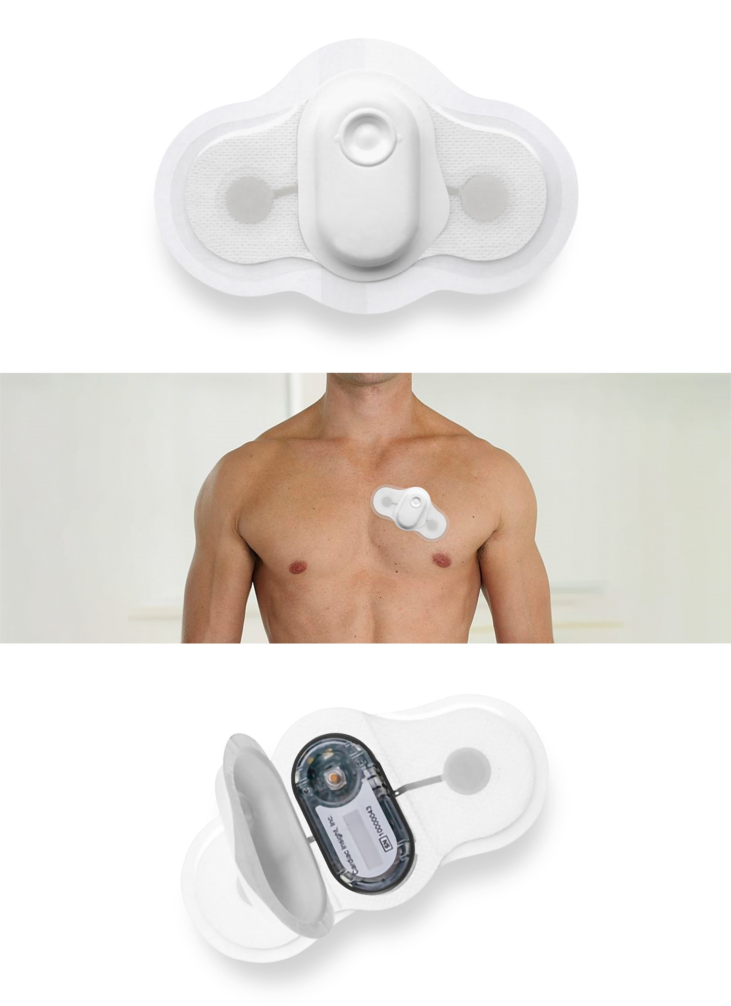
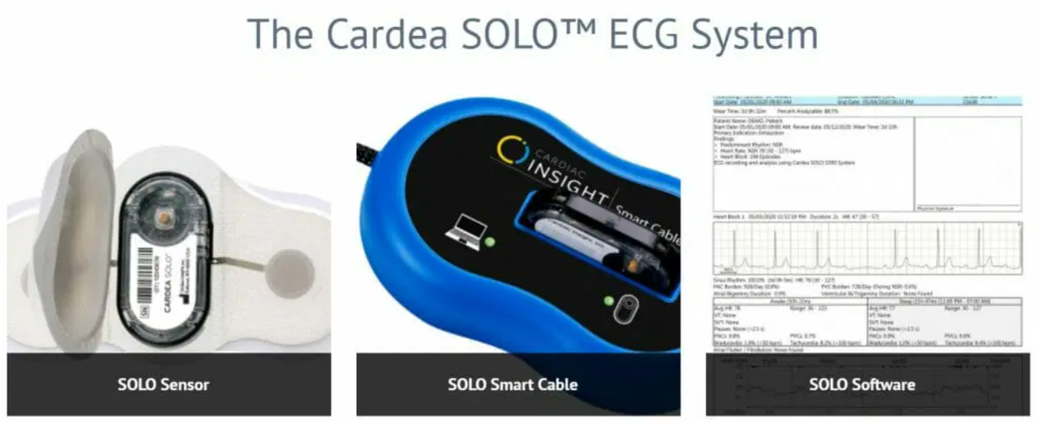
Consumer Health Tech
Cardea SOLO™ is a single-use, disposable, wireless electrocardiogram (ECG) monitoring system. It's designed for short-term cardiac monitoring, typically up to 7 days, to detect and diagnose cardiac arrhythmias, including atrial fibrillation (AFib). Unlike traditional Holter monitors or event recorders, Cardea SOLO is a patch-based system that simplifies the monitoring process for both patients and clinicians.
Salient features:
Single-Use and Disposable.
Wireless and Leadless.
Continuous ECG Recording.
Automated Analysis.
Cloud-Based Platform.
Clinician Review and Reporting.
Simplified Application and Removal.
Water-Resistant.
Key Advantages:
Improved Patient Compliance.
Simplified Workflow for Clinicians.
Enhanced Diagnostic Yield.
Reduced Risk of Infection.
Remote Monitoring Capabilities.
Notes:
Cardea SOLO™ is a single-use, disposable, wireless electrocardiogram (ECG) monitoring system.¹ It's designed for short-term cardiac monitoring, typically up to 7 days, to detect and diagnose cardiac arrhythmias, including atrial fibrillation (AFib).² Unlike traditional Holter monitors or event recorders, Cardea SOLO is a patch-based system that simplifies the monitoring process for both patients and clinicians.³
Salient Features:
Single-Use and Disposable: The patch is applied to the patient's chest and worn continuously for the prescribed monitoring period.⁴ After use, the entire device is discarded, eliminating the need for cleaning, returning equipment, or transferring data manually. This significantly reduces the risk of cross-contamination and simplifies logistics for clinics.⁵
Wireless and Leadless: Cardea SOLO is a completely wireless and leadless system.⁶ This improves patient comfort and allows for greater freedom of movement compared to traditional Holter monitors with wires and electrodes.⁷
Continuous ECG Recording: The patch continuously records the patient's ECG data throughout the monitoring period.⁸
Automated Analysis: The system uses proprietary algorithms to automatically analyze the ECG data and identify potential arrhythmias.⁹
Cloud-Based Platform: The recorded ECG data is transmitted wirelessly to a secure cloud-based platform, where it can be accessed by clinicians.
Clinician Review and Reporting: Clinicians can review the ECG data, confirm or reject automated findings, and generate reports for diagnosis and treatment planning.¹⁰
Simplified Application and Removal: The patch is designed for easy application and removal, minimizing the need for specialized training or assistance.¹¹
Water-Resistant: The patch is designed to be water-resistant, allowing patients to continue their normal daily activities, including showering.¹²
Key Advantages:
Improved Patient Compliance: The comfortable and leadless design improves patient compliance with monitoring protocols.¹³
Simplified Workflow for Clinicians: The disposable nature and automated analysis simplify the monitoring process for clinicians, reducing administrative burden and improving efficiency.¹⁴
Enhanced Diagnostic Yield: Continuous monitoring can improve the detection rate of intermittent arrhythmias compared to shorter ECG recordings.¹⁵
Reduced Risk of Infection: The single-use design minimizes the risk of cross-contamination.¹⁶
Remote Monitoring Capabilities: The cloud-based platform allows for remote access to ECG data, enabling clinicians to monitor patients from anywhere.
Key Use Cases:
Detection and Diagnosis of Cardiac Arrhythmias: Particularly useful for detecting paroxysmal (intermittent) AFib and other arrhythmias.
Post-Operative Monitoring: Monitoring patients after cardiac procedures.
Pre-Operative Assessment: Assessing patients' cardiac risk before surgery.
Evaluation of Syncope (Fainting): Investigating the cause of unexplained fainting episodes.
Important Considerations:
Prescription Required: Cardea SOLO is a medical device and requires a prescription from a healthcare provider.
Short-Term Monitoring: It's designed for short-term monitoring (up to 7 days), not for continuous long-term monitoring.
Cost: While offering advantages in terms of convenience and workflow, the cost per test might be a consideration compared to traditional Holter monitoring.
Cardea SOLO offers a significant advancement in short-term cardiac monitoring by simplifying the process for both patients and clinicians.¹⁷ Its disposable, wireless, and automated features make it a valuable tool for detecting and diagnosing cardiac arrhythmias.

Slide 16
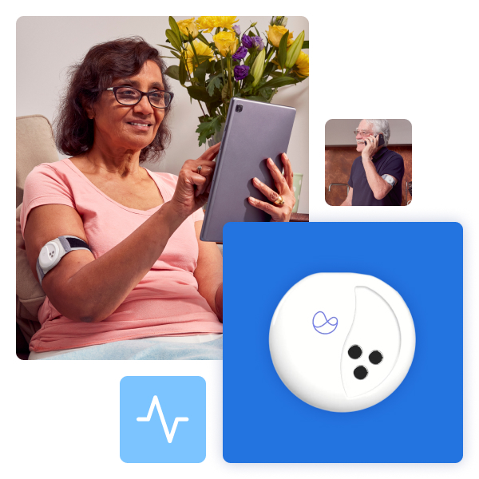
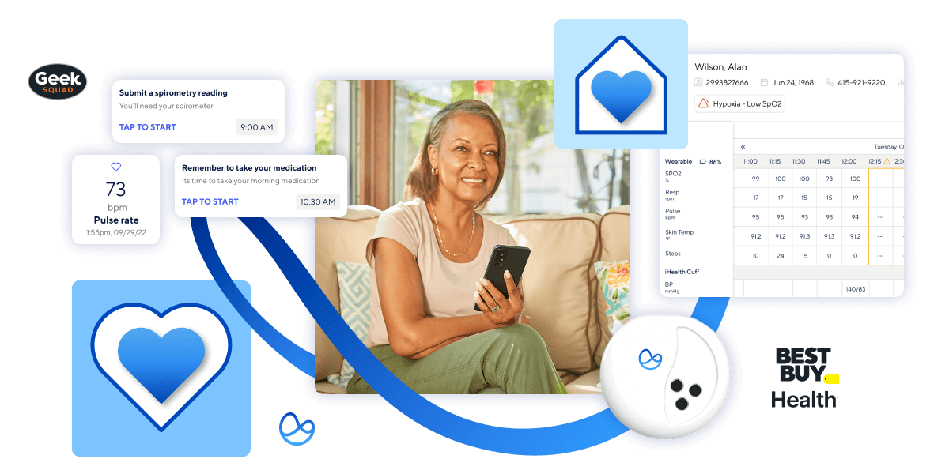
Consumer Health Tech
Current Health (now part of Best Buy Health) is a remote patient monitoring (RPM) platform that combines wearable sensors, software, and services to enable continuous monitoring of patients outside of traditional healthcare settings. It's designed to facilitate proactive care, improve patient outcomes, and reduce healthcare costs. Unlike single-purpose wearable devices, Current Health provides a more comprehensive platform approach.
Salient features:
Wearable Sensors.
Wrist-worn sensor.
Optional wireless blood pressure cuff.
Optional weight scale.
Continuous Physiological Data Collection.
Data Aggregation and Integration.
AI-Powered Analytics and Risk Prediction.
Remote Monitoring by Healthcare Providers.
Two-Way Communication.
Care Management Workflows.
Integration with Existing Healthcare Systems.
Scalable Platform.
Key Advantages:
Proactive Care.
Improved Patient Engagement.
Reduced Healthcare Costs.
Enhanced Clinical Decision-Making.
Flexibility and Customization.
Notes:
Current Health (now part of Best Buy Health) is a remote patient monitoring (RPM) platform that combines wearable sensors, software, and services to enable continuous monitoring of patients outside of traditional healthcare settings.¹ It's designed to facilitate proactive care, improve patient outcomes, and reduce healthcare costs. Unlike single-purpose wearable devices, Current Health provides a more comprehensive platform approach.
Salient Features:
Wearable Sensors: Current Health uses a combination of FDA-cleared wearable sensors, including:
Wrist-worn sensor: Measures vital signs like heart rate, respiratory rate, oxygen saturation (SpO2), activity, and sleep.
Optional wireless blood pressure cuff: For regular blood pressure measurements.
Optional weight scale: For tracking weight.
Continuous Physiological Data Collection: The sensors continuously collect physiological data, providing a real-time view of the patient's condition.
Data Aggregation and Integration: The platform aggregates data from the wearable sensors and can integrate with other data sources, such as electronic health records (EHRs).²
AI-Powered Analytics and Risk Prediction: Current Health uses AI algorithms to analyze the collected data and identify patterns or trends that may indicate a deterioration in the patient's condition. This allows for proactive intervention by healthcare providers.
Remote Monitoring by Healthcare Providers: Healthcare providers can access the patient's data through a secure web-based portal or mobile app. They can view trends, receive alerts for concerning changes, and communicate with patients remotely.
Two-Way Communication: The platform facilitates two-way communication between patients and healthcare providers through secure messaging, video calls, and other communication tools.³
Care Management Workflows: Current Health provides care management workflows that help healthcare providers manage their remote patient monitoring programs efficiently.
Integration with Existing Healthcare Systems: The platform is designed to integrate with existing EHRs and other healthcare systems to streamline data sharing and workflows.
Scalable Platform: Current Health is designed to be scalable, allowing healthcare organizations to monitor large populations of patients remotely.
Key Advantages:
Proactive Care: Continuous monitoring and AI-powered analytics enable proactive intervention, potentially preventing hospital readmissions and improving patient outcomes.
Improved Patient Engagement: Remote monitoring and two-way communication can improve patient engagement in their own care.⁴
Reduced Healthcare Costs: By preventing hospital readmissions and enabling more efficient care management, Current Health can help reduce healthcare costs.
Enhanced Clinical Decision-Making: The platform provides healthcare providers with more comprehensive data and insights, supporting better clinical decision-making.⁵
Flexibility and Customization: The platform can be customized to meet the specific needs of different healthcare organizations and patient populations.⁶
Key Use Cases:
Chronic Disease Management: Monitoring patients with chronic conditions such as heart failure, COPD, and diabetes.⁷
Post-Acute Care: Monitoring patients after hospital discharge to prevent readmissions.
Hospital at Home Programs: Enabling hospital-level care to be delivered in the patient's home.⁸
Clinical Trials: Collecting physiological data in clinical research studies.
Important Considerations:
Requires Healthcare Provider Involvement: Current Health is a platform for healthcare providers to monitor patients remotely, not a direct-to-consumer product.
Data Privacy and Security: Protecting patient data is a critical aspect of the platform.
Current Health represents a comprehensive approach to remote patient monitoring, combining wearable sensors, software, and services to empower healthcare providers to deliver more proactive and effective care.

Slide 17
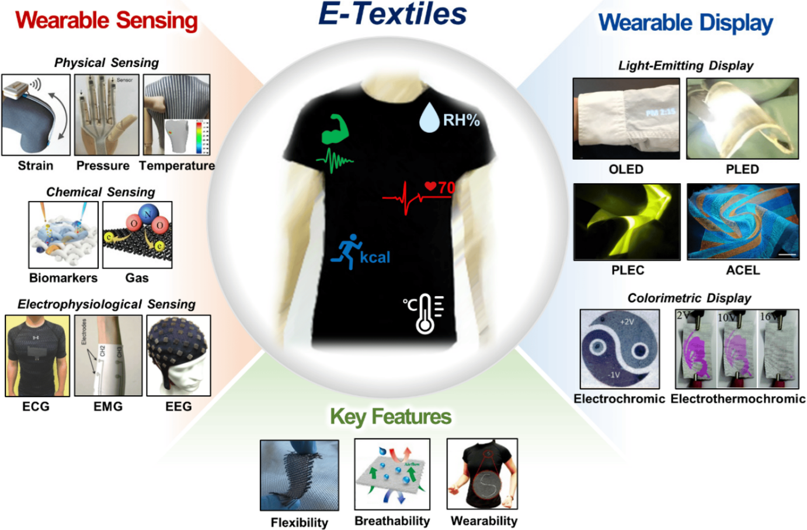
EMERGING NEW Health Tech
Smart clothing also known as e-textiles or smart textiles, integrates electronic components and sensors directly into fabrics or garments. This allows the clothing to sense, monitor, and react to various stimuli, providing data and functionality beyond traditional apparel.
Salient features:
Integrated Sensors: Smart clothing incorporates various types of sensors to gather data:
Physiological Sensors: These sensors monitor bodily functions:
Heart rate sensors (ECG/PPG).
Respiration sensors.
Temperature sensors.
Electromyography (EMG) sensors.
Sweat sensors.
Motion Sensors: These sensors track movement and activity:
Accelerometers.
Gyroscopes.
Magnetometers.
Environmental Sensors: These sensors gather data about the environment:
Light sensors.
Temperature and humidity sensors.
Gas sensors.
Notes:
Current Health (now part of Best Buy Health) is a remote patient monitoring (RPM) platform that combines wearable sensors, software, and services to enable continuous monitoring of patients outside of traditional healthcare settings.¹ It's designed to facilitate proactive care, improve patient outcomes, and reduce healthcare costs. Unlike single-purpose wearable devices, Current Health provides a more comprehensive platform approach.
Salient Features:
Wearable Sensors: Current Health uses a combination of FDA-cleared wearable sensors, including:
Wrist-worn sensor: Measures vital signs like heart rate, respiratory rate, oxygen saturation (SpO2), activity, and sleep.
Optional wireless blood pressure cuff: For regular blood pressure measurements.
Optional weight scale: For tracking weight.
Continuous Physiological Data Collection: The sensors continuously collect physiological data, providing a real-time view of the patient's condition.
Data Aggregation and Integration: The platform aggregates data from the wearable sensors and can integrate with other data sources, such as electronic health records (EHRs).²
AI-Powered Analytics and Risk Prediction: Current Health uses AI algorithms to analyze the collected data and identify patterns or trends that may indicate a deterioration in the patient's condition. This allows for proactive intervention by healthcare providers.
Remote Monitoring by Healthcare Providers: Healthcare providers can access the patient's data through a secure web-based portal or mobile app. They can view trends, receive alerts for concerning changes, and communicate with patients remotely.
Two-Way Communication: The platform facilitates two-way communication between patients and healthcare providers through secure messaging, video calls, and other communication tools.³
Care Management Workflows: Current Health provides care management workflows that help healthcare providers manage their remote patient monitoring programs efficiently.
Integration with Existing Healthcare Systems: The platform is designed to integrate with existing EHRs and other healthcare systems to streamline data sharing and workflows.
Scalable Platform: Current Health is designed to be scalable, allowing healthcare organizations to monitor large populations of patients remotely.
Key Advantages:
Proactive Care: Continuous monitoring and AI-powered analytics enable proactive intervention, potentially preventing hospital readmissions and improving patient outcomes.
Improved Patient Engagement: Remote monitoring and two-way communication can improve patient engagement in their own care.⁴
Reduced Healthcare Costs: By preventing hospital readmissions and enabling more efficient care management, Current Health can help reduce healthcare costs.
Enhanced Clinical Decision-Making: The platform provides healthcare providers with more comprehensive data and insights, supporting better clinical decision-making.⁵
Flexibility and Customization: The platform can be customized to meet the specific needs of different healthcare organizations and patient populations.⁶
Key Use Cases:
Chronic Disease Management: Monitoring patients with chronic conditions such as heart failure, COPD, and diabetes.⁷
Post-Acute Care: Monitoring patients after hospital discharge to prevent readmissions.
Hospital at Home Programs: Enabling hospital-level care to be delivered in the patient's home.⁸
Clinical Trials: Collecting physiological data in clinical research studies.
Important Considerations:
Requires Healthcare Provider Involvement: Current Health is a platform for healthcare providers to monitor patients remotely, not a direct-to-consumer product.
Data Privacy and Security: Protecting patient data is a critical aspect of the platform.
Current Health represents a comprehensive approach to remote patient monitoring, combining wearable sensors, software, and services to empower healthcare providers to deliver more proactive and effective care.

Slide 18
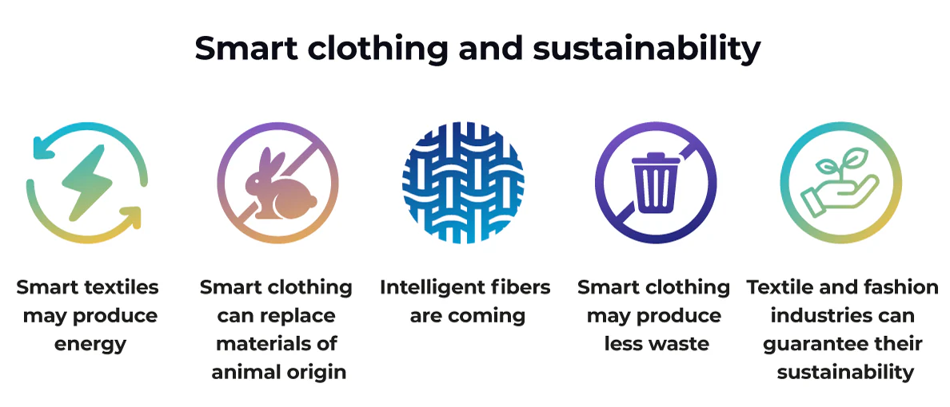
EMERGING NEW Health Tech
Smart clothing also known as e-textiles or smart textiles, integrates electronic components and sensors directly into fabrics or garments. This allows the clothing to sense, monitor, and react to various stimuli, providing data and functionality beyond traditional apparel.
Salient features:
Conductive Fabrics and Yarns: Conductive materials are woven or knitted into the fabric to create circuits and connect the sensors to processing units. These materials can be:
Metal-coated fibers.
Conductive polymers.
Carbon nanotubes or graphene-based materials.
Key Advantages:
Proactive Care.
Improved Patient Engagement.
Reduced Healthcare Costs.
Enhanced Clinical Decision-Making.
Flexibility and Customization.
Notes:
Smart clothing, also known as e-textiles or smart textiles, integrates electronic components and sensors directly into fabrics or garments.¹ This allows the clothing to sense, monitor, and react to various stimuli, providing data and functionality beyond traditional apparel.²
Salient Features of Smart Clothing:
Integrated Sensors: Smart clothing incorporates various types of sensors to gather data:³
Physiological Sensors: These sensors monitor bodily functions:⁴
Heart rate sensors (ECG/PPG): Track heart rate and heart rhythm.⁵
Respiration sensors: Monitor breathing rate and patterns.⁶
Temperature sensors: Measure skin temperature.⁷
Electromyography (EMG) sensors: Measure muscle activity.⁸
Sweat sensors: Analyze sweat composition for biomarkers.⁹
Motion Sensors: These sensors track movement and activity:¹⁰
Accelerometers: Measure acceleration and movement.¹¹
Gyroscopes: Measure orientation and rotation.¹²
Magnetometers: Measure magnetic fields and can be used for direction sensing.¹³
Environmental Sensors: These sensors gather data about the environment:¹⁴
Light sensors: Measure ambient light levels.
Temperature and humidity sensors: Monitor environmental conditions.¹⁵
Gas sensors: Detect the presence of specific gases.¹⁶
Conductive Fabrics and Yarns: Conductive materials are woven or knitted into the fabric to create circuits and connect the sensors to processing units.¹⁷ These materials can be:
Metal-coated fibers: Fibers coated with conductive metals like silver or copper.¹⁸
Conductive polymers: Polymers that can conduct electricity.¹⁹
Carbon nanotubes or graphene-based materials: Nanomaterials with excellent conductivity.²⁰
Microcontrollers and Processing Units: Small electronic circuits are integrated into the garment to process the data collected by the sensors.²¹ These units can perform tasks like signal processing, data storage, and wireless communication.
Wireless Communication: Smart clothing typically uses wireless technologies like Bluetooth Low Energy (BLE) or Wi-Fi to transmit data to a smartphone, computer, or other devices.²²
Power Source: Smart clothing requires a power source, which can be:
Batteries: Small, flexible batteries can be integrated into the garment.²³
Energy harvesting technologies: Research is ongoing into harvesting energy from body heat, movement, or light to power smart clothing.²⁴
Washability and Durability: A key challenge in smart clothing development is ensuring that the electronic components and connections can withstand repeated washing and wear.²⁵
Key Applications of Smart Clothing:
Health and Wellness: Monitoring vital signs, tracking activity levels, and providing personalized health insights.²⁶
Sports and Fitness: Tracking athletic performance, providing real-time feedback during workouts, and preventing injuries.²⁷
Medical and Healthcare: Remote patient monitoring, rehabilitation, and early detection of health conditions.²⁸
Military and Defense: Monitoring soldier health and performance, providing tactical information, and enhancing communication.²⁹
Fashion and Entertainment: Creating interactive and responsive garments.³⁰
Key Advantages:
Continuous and Passive Monitoring: Smart clothing can provide continuous monitoring of physiological and environmental data without requiring conscious effort from the user.³¹
Comfort and Convenience: Integrating sensors and electronics into clothing can be more comfortable and convenient than wearing separate devices.³²
Real-Time Feedback: Smart clothing can provide real-time feedback to the user, allowing for immediate adjustments in behavior or activity.³³
Key Challenges:
Washability and Durability: Ensuring the electronics can withstand washing and wear.
Power Management: Developing efficient and long-lasting power sources.
Data Privacy and Security: Protecting the sensitive data collected by smart clothing.³⁴
Cost and Scalability: Making smart clothing affordable and scalable for mass production.
Smart clothing represents a promising area of sensor technology and wearables, with the potential to revolutionize various industries.³⁵ Ongoing research and development are focused on overcoming the existing challenges and creating more advanced, comfortable, and practical smart garments.

Slide 19
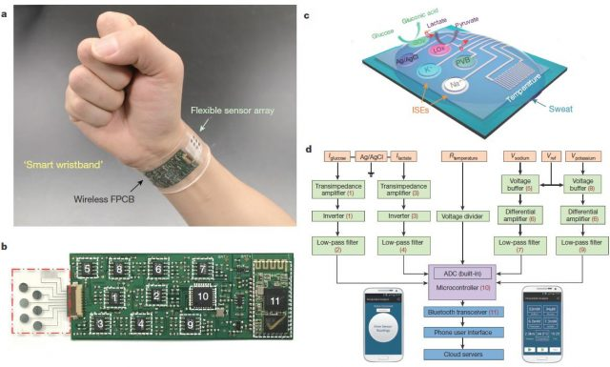
EMERGING NEW Health Tech
Sweat analysis involves collecting and analyzing sweat to extract information about an individual's physiological state. Sweat contains various biomarkers, including electrolytes, metabolites, hormones, and proteins, which can provide insights into hydration status, electrolyte balance, stress levels, metabolic activity, and even certain disease states. Sweat analysis patches are wearable devices designed to collect and analyze sweat non-invasively.
5 salient features of sweat analysis :
Non-Invasive and Continuous Monitoring
Detection of a Wide Range of Biomarkers: Sweat contains a variety of analytes that can be measured, including:
Electrolytes.
Metabolites.
Hormones.
Proteins and Peptides.
Drugs and other exogenous substances..
Real-Time or Near Real-Time Analysis
Personalized Insights and Applications: The data obtained from sweat analysis can be used
Hydration Management.
Performance Optimization.
Stress Monitoring.
Disease Monitoring.
Potential for Miniaturization and Integration
Notes:
Sweat analysis involves collecting and analyzing sweat to extract information about an individual's physiological state.¹ Sweat contains various biomarkers, including electrolytes, metabolites, hormones, and proteins, which can provide insights into hydration status, electrolyte balance, stress levels, metabolic activity, and even certain disease states.² Sweat analysis patches are wearable devices designed to collect and analyze sweat non-invasively.³
Here are 5 salient features of sweat analysis (and by extension, sweat analysis patches):
Non-Invasive and Continuous Monitoring: Sweat analysis offers a non-invasive alternative to traditional blood tests for monitoring certain biomarkers.⁴ Sweat analysis patches can be worn for extended periods, enabling continuous monitoring of these biomarkers over time, providing a more dynamic picture of physiological changes.⁵
Detection of a Wide Range of Biomarkers: Sweat contains a variety of analytes that can be measured, including:
Electrolytes: Sodium, potassium, chloride, magnesium – Provide information about hydration status and electrolyte balance.
Metabolites: Glucose, lactate, urea – Reflect metabolic activity and can be relevant for diabetes management or athletic performance.
Hormones: Cortisol – A stress hormone; can be used to monitor stress levels.⁶
Proteins and Peptides: Can potentially indicate certain health conditions or physiological states.⁷
Drugs and other exogenous substances: Can be used for drug testing or monitoring exposure to environmental toxins.⁸
Real-Time or Near Real-Time Analysis: Some sweat analysis patches are designed for real-time or near real-time analysis, providing immediate feedback to the user or transmitting data wirelessly to a smartphone or other device.⁹ This enables timely interventions or adjustments based on the analyzed data. Other patches collect sweat over a period of time for later lab analysis.¹⁰
Personalized Insights and Applications: The data obtained from sweat analysis can be used to provide personalized insights into an individual's health, fitness, or performance.¹¹ This can be valuable for:
Hydration Management: Monitoring electrolyte loss during exercise to optimize hydration strategies.¹²
Performance Optimization: Tracking lactate levels during workouts to adjust training intensity.¹³
Stress Monitoring: Tracking cortisol levels to manage stress.¹⁴
Disease Monitoring: Monitoring glucose levels for diabetes management or other relevant biomarkers for specific conditions.¹⁵
Potential for Miniaturization and Integration: Sweat analysis patches can be designed to be small, flexible, and comfortable to wear. They can be integrated into other wearable devices or even incorporated into clothing.¹⁶ This makes them a convenient and unobtrusive way to collect physiological data.
How Sweat Analysis Patches Work (in general):
Sweat analysis patches typically consist of several key components:
Sweat Collection Microfluidics: Microchannels and reservoirs designed to collect and wick sweat from the skin.¹⁷
Sensing Elements: Electrochemical, optical, or other types of sensors that detect and measure specific biomarkers in the collected sweat.¹⁸
Electronics and Communication: Circuitry for signal processing, data storage, and wireless transmission (if applicable).¹⁹
Adhesive Layer: A biocompatible adhesive to secure the patch to the skin.²⁰
Sweat analysis is a rapidly developing field with the potential to significantly impact various areas, including healthcare, sports, and personal wellness.²¹ Ongoing research is focused on improving sensor accuracy, expanding the range of detectable biomarkers, and developing more sophisticated and user-friendly sweat analysis patches.²²

Slide 20
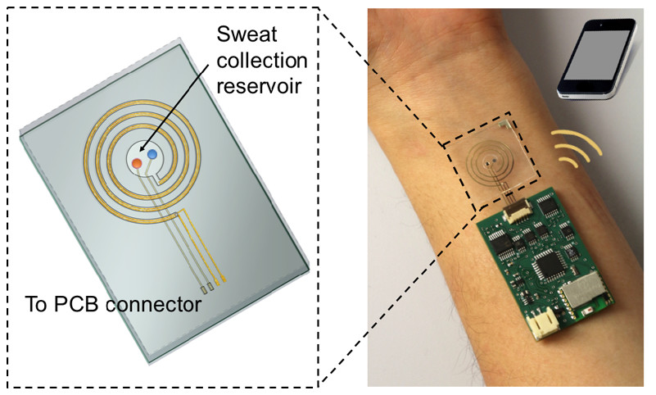
EMERGING NEW Health Tech
Sweat analysis involves collecting and analyzing sweat to extract information about an individual's physiological state. Sweat contains various biomarkers, including electrolytes, metabolites, hormones, and proteins, which can provide insights into hydration status, electrolyte balance, stress levels, metabolic activity, and even certain disease states. Sweat analysis patches are wearable devices designed to collect and analyze sweat non-invasively.
How Sweat Analysis Patches Work (in general):
Sweat analysis patches typically consist of several key components:
Sweat Collection Microfluidics: Microchannels and reservoirs designed to collect and wick sweat from the skin.
Sensing Elements: Electrochemical, optical, or other types of sensors that detect and measure specific biomarkers in the collected sweat.
Electronics and Communication: Circuitry for signal processing, data storage, and wireless transmission (if applicable).
Adhesive Layer: A biocompatible adhesive to secure the patch to the skin.
Notes:
Sweat analysis involves collecting and analyzing sweat to extract information about an individual's physiological state.¹ Sweat contains various biomarkers, including electrolytes, metabolites, hormones, and proteins, which can provide insights into hydration status, electrolyte balance, stress levels, metabolic activity, and even certain disease states.² Sweat analysis patches are wearable devices designed to collect and analyze sweat non-invasively.³
Here are 5 salient features of sweat analysis (and by extension, sweat analysis patches):
Non-Invasive and Continuous Monitoring: Sweat analysis offers a non-invasive alternative to traditional blood tests for monitoring certain biomarkers.⁴ Sweat analysis patches can be worn for extended periods, enabling continuous monitoring of these biomarkers over time, providing a more dynamic picture of physiological changes.⁵
Detection of a Wide Range of Biomarkers: Sweat contains a variety of analytes that can be measured, including:
Electrolytes: Sodium, potassium, chloride, magnesium – Provide information about hydration status and electrolyte balance.
Metabolites: Glucose, lactate, urea – Reflect metabolic activity and can be relevant for diabetes management or athletic performance.
Hormones: Cortisol – A stress hormone; can be used to monitor stress levels.⁶
Proteins and Peptides: Can potentially indicate certain health conditions or physiological states.⁷
Drugs and other exogenous substances: Can be used for drug testing or monitoring exposure to environmental toxins.⁸
Real-Time or Near Real-Time Analysis: Some sweat analysis patches are designed for real-time or near real-time analysis, providing immediate feedback to the user or transmitting data wirelessly to a smartphone or other device.⁹ This enables timely interventions or adjustments based on the analyzed data. Other patches collect sweat over a period of time for later lab analysis.¹⁰
Personalized Insights and Applications: The data obtained from sweat analysis can be used to provide personalized insights into an individual's health, fitness, or performance.¹¹ This can be valuable for:
Hydration Management: Monitoring electrolyte loss during exercise to optimize hydration strategies.¹²
Performance Optimization: Tracking lactate levels during workouts to adjust training intensity.¹³
Stress Monitoring: Tracking cortisol levels to manage stress.¹⁴
Disease Monitoring: Monitoring glucose levels for diabetes management or other relevant biomarkers for specific conditions.¹⁵
Potential for Miniaturization and Integration: Sweat analysis patches can be designed to be small, flexible, and comfortable to wear. They can be integrated into other wearable devices or even incorporated into clothing.¹⁶ This makes them a convenient and unobtrusive way to collect physiological data.
How Sweat Analysis Patches Work (in general):
Sweat analysis patches typically consist of several key components:
Sweat Collection Microfluidics: Microchannels and reservoirs designed to collect and wick sweat from the skin.¹⁷
Sensing Elements: Electrochemical, optical, or other types of sensors that detect and measure specific biomarkers in the collected sweat.¹⁸
Electronics and Communication: Circuitry for signal processing, data storage, and wireless transmission (if applicable).¹⁹
Adhesive Layer: A biocompatible adhesive to secure the patch to the skin.²⁰
Sweat analysis is a rapidly developing field with the potential to significantly impact various areas, including healthcare, sports, and personal wellness.²¹ Ongoing research is focused on improving sensor accuracy, expanding the range of detectable biomarkers, and developing more sophisticated and user-friendly sweat analysis patches.²²

Slide 21
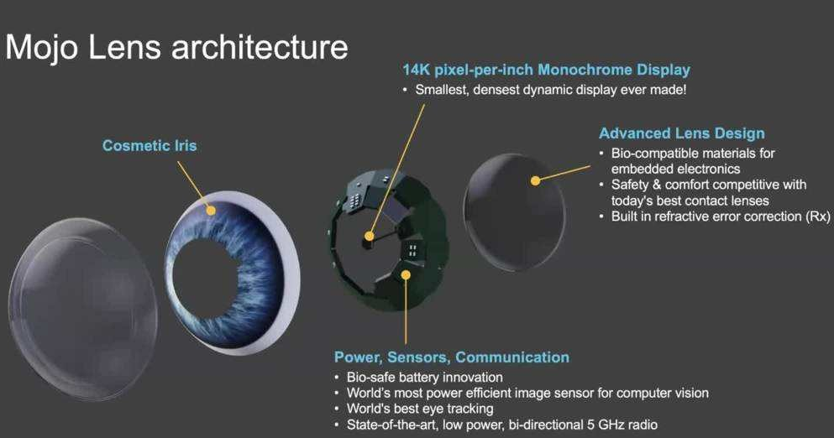
EMERGING NEW Health Tech
Smart contact lenses are advanced contact lenses embedded with miniaturized sensors, microelectronics, and other technologies to monitor various physiological parameters or provide augmented reality (AR) experiences. They represent a convergence of biomedical engineering, microelectronics, and materials science.
Salient Features:
Biosensing Capabilities: A primary focus of smart contact lenses is biosensing, allowing for non-invasive monitoring of various biomarkers in tears, which are closely correlated with blood composition.
This can be used to detect:
Glucose.
Lactate.
Other biomarkers.
Continuous Monitoring.
Wireless Communication.
Power Source. Current approaches include:
Wireless power transfer.
Miniature batteries.
Notes:
Smart contact lenses are advanced contact lenses embedded with miniaturized sensors, microelectronics, and other technologies to monitor various physiological parameters or provide augmented reality (AR) experiences. They represent a convergence of biomedical engineering, microelectronics, and materials science.
Here are 7 salient features of Smart contact lenses:
Biosensing Capabilities: A primary focus of smart contact lenses is biosensing, allowing for non-invasive monitoring of various biomarkers in tears, which are closely correlated with blood composition. This can be used to detect:
Glucose: For continuous glucose monitoring in diabetes management.
Lactate: For monitoring metabolic activity.
Other biomarkers: Research is ongoing to detect various other biomarkers related to different health conditions.
Continuous Monitoring: Unlike traditional diagnostic methods that provide a snapshot in time, smart contact lenses offer the potential for continuous, real-time monitoring of biomarkers, providing a more dynamic and comprehensive view of physiological changes.
Wireless Communication: Smart contact lenses typically incorporate wireless communication technologies, such as Bluetooth Low Energy (BLE) or near-field communication (NFC), to transmit the collected data to an external device, such as a smartphone or computer.
Power Source: Powering the microelectronics within a contact lens is a significant challenge. Current approaches include:
Wireless power transfer: Using inductive coupling or radio frequency (RF) energy harvesting to wirelessly power the lens.
Miniature batteries: Integrating tiny, flexible batteries into the lens.
Integration with Microelectronics: Smart contact lenses integrate various microelectronic components, including:
Sensors: To detect and measure the target biomarkers or other parameters.
Microprocessors: To process the sensor data.
Antennas: For wireless communication.
Microfluidics: To manage the flow of tears across the sensors.
Augmented Reality (AR) Capabilities (in some designs): Some smart contact lens designs aim to provide augmented reality experiences by incorporating microdisplays into the lens. This could be used for:
Overlaying information onto the user's field of view: Such as directions, notifications, or other data.
Vision correction: Potentially correcting refractive errors or other vision impairments.
Biocompatibility and Comfort: Ensuring the lens is biocompatible and comfortable for extended wear is crucial. This involves careful selection of materials and lens design to minimize irritation and maintain eye health.
==========MOJO VISION ARCHITECTURE================== Mojo Vision, the company behind the Mojo Lens, was developing a smart contact lens with a focus on augmented reality (AR). While the company has pivoted away from directly commercializing a consumer AR contact lens due to funding and technical challenges, their work provides valuable insights into the architectural considerations for such devices. Here's a breakdown of the key architectural elements they were pursuing:
Key Architectural Components of the Mojo Lens (as envisioned):
Microdisplay: This was the core of the AR functionality. Mojo Vision aimed to use a tiny MicroLED display integrated into the lens. This display would project images directly onto the retina, creating an AR overlay on the user's field of view.
High Pixel Density: Crucial for sharp and clear images.
Low Power Consumption: Essential for a battery-powered device worn directly on the eye.
Microprocessor and Control Circuitry: A small, low-power chip was needed to process the image data and control the microdisplay. This chip would handle tasks like:
Image processing and rendering: Generating the AR graphics.
Wireless communication: Receiving data from external devices.
Power management: Controlling the power consumption of the lens.
Power System: Powering the lens was a significant challenge. Mojo Vision explored various approaches, including:
Wireless power transfer: Using inductive coupling or RF energy harvesting to wirelessly transmit power to the lens. This was the primary focus.
Micro-batteries: Integrating tiny, flexible batteries within the lens structure (a more challenging approach).
Communication System: Wireless communication was essential for receiving data and instructions from external devices (e.g., a smartphone). Mojo Lens aimed to use:
Low-power wireless protocols: Such as Bluetooth Low Energy (BLE) or a proprietary low-power communication system.
Eye Tracking: To ensure that the AR images are displayed correctly and interactively, eye tracking was crucial. Mojo Vision explored using:
Miniature motion sensors: To track the movement of the eye.
Scleral Lens Design: The lens itself was designed as a scleral lens, meaning it rests on the sclera (the white part of the eye) rather than directly on the cornea. This design provided a more stable platform for the electronics and allowed for better alignment of the display with the pupil.
Biocompatibility and Oxygen Permeability: The lens materials had to be biocompatible to avoid irritation or damage to the eye. Oxygen permeability was also crucial to ensure the cornea receives enough oxygen.

Slide 22
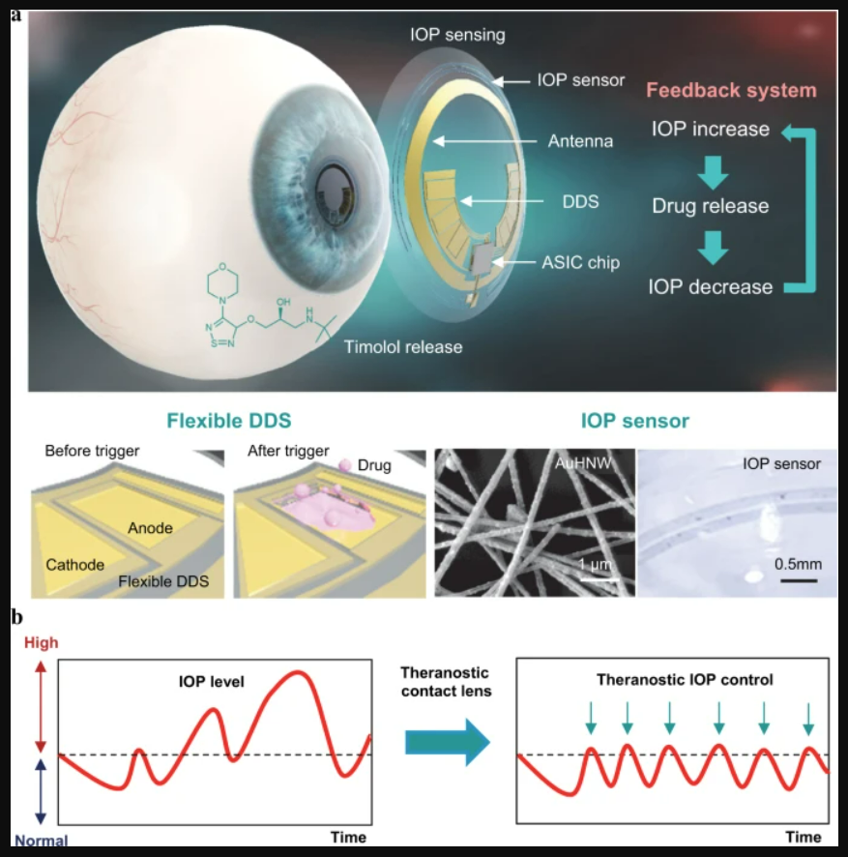
EMERGING NEW Health Tech
Smart contact lenses are advanced contact lenses embedded with miniaturized sensors, microelectronics, and other technologies to monitor various physiological parameters or provide augmented reality (AR) experiences. They represent a convergence of biomedical engineering, microelectronics, and materials science.
Salient Features:
Integration with Microelectronics: Smart contact lenses integrate various microelectronic components, including:
Sensors.
Microprocessors.
Antennas.
Microfluidics.
Augmented Reality (AR) Capabilities (in some designs). This could be used for:
Overlaying information onto the user's field of view.
Vision correction.
Biocompatibility and Comfort.
Notes:
Integration with Microelectronics: Smart contact lenses integrate various microelectronic components, including:
Sensors: To detect and measure the target biomarkers or other parameters.
Microprocessors: To process the sensor data.
Antennas: For wireless communication.
Microfluidics: To manage the flow of tears across the sensors.
Augmented Reality (AR) Capabilities (in some designs): Some smart contact lens designs aim to provide augmented reality experiences by incorporating microdisplays into the lens. This could be used for:
Overlaying information onto the user's field of view: Such as directions, notifications, or other data.
Vision correction: Potentially correcting refractive errors or other vision impairments.
Biocompatibility and Comfort: Ensuring the lens is biocompatible and comfortable for extended wear is crucial. This involves careful selection of materials and lens design to minimize irritation and maintain eye health.
Current Status and Challenges:
While significant progress has been made in the development of smart contact lenses, several challenges remain:
Miniaturization and Integration: Integrating all the necessary components into a small, thin, and flexible lens is technically challenging.
Power Efficiency: Developing efficient and reliable power sources is a major hurdle.
Biocompatibility and Long-Term Wear: Ensuring long-term biocompatibility and comfort is essential for widespread adoption.
Regulatory Approvals: Obtaining regulatory approvals for medical applications requires rigorous testing and clinical trials.
Despite these challenges, smart contact lens technology holds immense potential for various applications in healthcare, vision correction, and augmented reality. Ongoing research and development are focused on overcoming these challenges and bringing this technology to the market

Slide 23
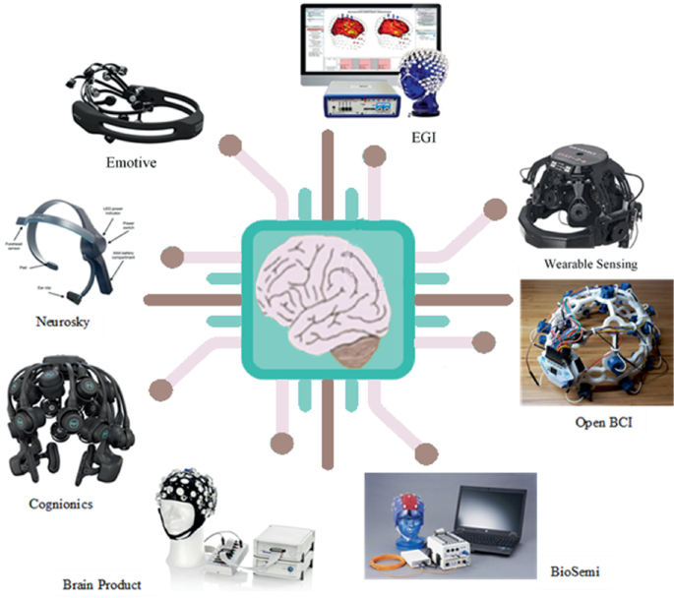
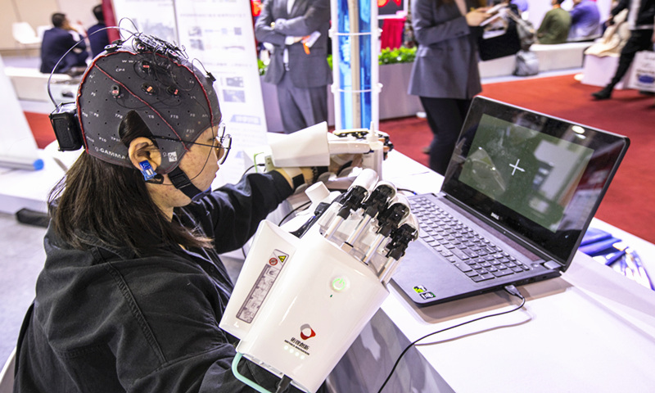
EMERGING NEW Health Tech
Brain-computer interfaces, sometimes referred to as brain-machine interfaces (BMIs), are systems that establish a direct communication pathway between the brain and an external device. They bypass traditional output pathways like muscles and nerves, allowing the brain to directly interact with and control technology.
Salient Features:
Neural Signal Acquisition: BCIs begin by acquiring neural signals from the brain. Several methods exist:
Electroencephalography (EEG).
Electrocorticography (ECoG).
Intracortical Electrodes.
Signal Processing: The raw neural signals acquired are often noisy and complex. Signal processing techniques are used to:
Filter noise.
Extract relevant features.
Convert signals into control commands.
Device Control/Output: The processed neural signals are then used to control an external device, which can be:
Cursor or computer interface.
Prosthetic limb.
Exoskeleton.
Communication device.
Neurofeedback systems.
Notes:
Brain-computer interfaces (BCIs), sometimes referred to as brain-machine interfaces (BMIs), are systems that establish a direct communication pathway between the brain and an external device.¹ They bypass traditional output pathways like muscles and nerves, allowing the brain to directly interact with and control technology.²
Here are the salient features of Brain-Computer Interfaces:
Neural Signal Acquisition: BCIs begin by acquiring neural signals from the brain.³ Several methods exist:
Electroencephalography (EEG): Non-invasive method using electrodes placed on the scalp to measure electrical activity in the brain.⁴ It has good temporal resolution but lower spatial resolution.⁵
Electrocorticography (ECoG): Minimally invasive method involving placing electrodes directly on the surface of the brain.⁶ It offers better spatial resolution than EEG but requires surgery.⁷
Intracortical Electrodes: Invasive method involving implanting microelectrodes directly into the brain tissue.⁸ It provides the highest spatial resolution and signal quality but carries the greatest risk.
Signal Processing: The raw neural signals acquired are often noisy and complex.⁹ Signal processing techniques are used to:
Filter noise: Remove unwanted signals and artifacts.¹⁰
Extract relevant features: Identify patterns in the neural data that correspond to specific intentions or commands.¹¹
Convert signals into control commands: Translate the processed neural signals into instructions that can be understood by the external device.¹²
Device Control/Output: The processed neural signals are then used to control an external device, which can be:
Cursor or computer interface: Allowing users to control a mouse cursor, type on a keyboard, or navigate a computer interface.¹³
Prosthetic limb: Enabling users to control a robotic arm or leg.¹⁴
Exoskeleton: Assisting with movement for individuals with paralysis.¹⁵
Communication device: Enabling individuals with severe motor impairments to communicate.¹⁶
Neurofeedback systems: Providing real-time feedback on brain activity to help users learn to self-regulate their brain function.¹⁷
Real-Time Operation: Many BCI applications require real-time or near real-time operation to provide immediate feedback or control.¹⁸ This necessitates efficient signal processing and communication.
Adaptation and Learning: Both the BCI system and the user need to adapt and learn over time.¹⁹ The system may need to be calibrated to the individual user's brain signals, and the user may need to learn how to control the BCI effectively.²⁰
Closed-Loop or Open-Loop Systems:
Open-loop systems: The BCI translates brain activity into commands, but there is no feedback provided back to the user about the outcome of those commands.²¹
Closed-loop systems: Provide feedback to the user, allowing them to adjust their brain activity based on the outcome.²² This feedback loop is crucial for learning and improving BCI control.²³
Applications in Healthcare, Rehabilitation, and Beyond: BCIs have a wide range of potential applications:²⁴
Restoring lost motor function: Enabling individuals with paralysis to control prosthetic limbs or other assistive devices.²⁵
Communication for locked-in syndrome: Providing a means of communication for individuals who are completely paralyzed.²⁶
Treatment of neurological disorders: Developing therapies for conditions like epilepsy, Parkinson's disease, and stroke.²⁷
Cognitive enhancement: Exploring the potential for BCIs to enhance cognitive abilities.²⁸
Gaming and entertainment: Developing new forms of human-computer interaction for gaming and entertainment.²⁹
Key Challenges:
Signal Quality and Noise: Acquiring clean and reliable neural signals can be challenging.
Decoding Neural Activity: Developing algorithms that can accurately decode complex brain activity is a significant challenge.
Invasiveness: Invasive methods offer better signal quality but carry risks associated with surgery.
Long-Term Stability and Biocompatibility: Ensuring the long-term stability and biocompatibility of implanted electrodes is crucial for invasive BCIs.³⁰
User Training and Adaptation: Users often require extensive training to learn how to control a BCI effectively.³¹
BCIs are a rapidly evolving field with the potential to significantly improve the lives of individuals with disabilities and enhance human capabilities.³² Ongoing research and development are focused on addressing the existing challenges and expanding the applications of this transformative technology.³³

Slide 24
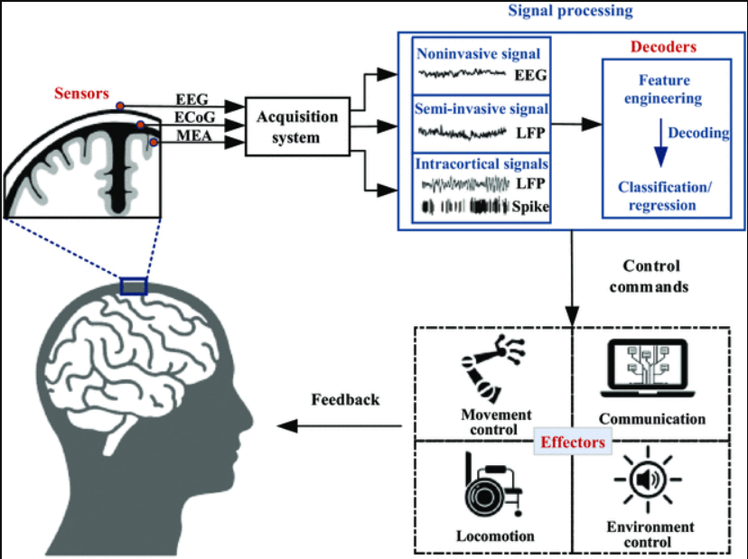
EMERGING NEW Health Tech
Brain-computer interfaces, sometimes referred to as brain-machine interfaces (BMIs), are systems that establish a direct communication pathway between the brain and an external device. They bypass traditional output pathways like muscles and nerves, allowing the brain to directly interact with and control technology.
Salient Features:
Real-Time Operation: Many BCI applications require real-time or near real-time operation to provide immediate feedback or control. This necessitates efficient signal processing and communication.
Adaptation and Learning: Both the BCI system and the user need to adapt and learn over time. The system may need to be calibrated to the individual user's brain signals, and the user may need to learn how to control the BCI effectively.
Closed-Loop or Open-Loop Systems:
Open-loop systems.
Closed-loop systems.
Applications in Healthcare, Rehabilitation, and Beyond: BCIs have a wide range of potential applications:
Restoring lost motor function.
Communication for locked-in syndrome.
Treatment of neurological disorders.
Cognitive enhancement.
Gaming and entertainment.
Notes:
Brain-computer interfaces (BCIs), sometimes referred to as brain-machine interfaces (BMIs), are systems that establish a direct communication pathway between the brain and an external device.¹ They bypass traditional output pathways like muscles and nerves, allowing the brain to directly interact with and control technology.²
Here are the salient features of Brain-Computer Interfaces:
Neural Signal Acquisition: BCIs begin by acquiring neural signals from the brain.³ Several methods exist:
Electroencephalography (EEG): Non-invasive method using electrodes placed on the scalp to measure electrical activity in the brain.⁴ It has good temporal resolution but lower spatial resolution.⁵
Electrocorticography (ECoG): Minimally invasive method involving placing electrodes directly on the surface of the brain.⁶ It offers better spatial resolution than EEG but requires surgery.⁷
Intracortical Electrodes: Invasive method involving implanting microelectrodes directly into the brain tissue.⁸ It provides the highest spatial resolution and signal quality but carries the greatest risk.
Signal Processing: The raw neural signals acquired are often noisy and complex.⁹ Signal processing techniques are used to:
Filter noise: Remove unwanted signals and artifacts.¹⁰
Extract relevant features: Identify patterns in the neural data that correspond to specific intentions or commands.¹¹
Convert signals into control commands: Translate the processed neural signals into instructions that can be understood by the external device.¹²
Device Control/Output: The processed neural signals are then used to control an external device, which can be:
Cursor or computer interface: Allowing users to control a mouse cursor, type on a keyboard, or navigate a computer interface.¹³
Prosthetic limb: Enabling users to control a robotic arm or leg.¹⁴
Exoskeleton: Assisting with movement for individuals with paralysis.¹⁵
Communication device: Enabling individuals with severe motor impairments to communicate.¹⁶
Neurofeedback systems: Providing real-time feedback on brain activity to help users learn to self-regulate their brain function.¹⁷
Real-Time Operation: Many BCI applications require real-time or near real-time operation to provide immediate feedback or control.¹⁸ This necessitates efficient signal processing and communication.
Adaptation and Learning: Both the BCI system and the user need to adapt and learn over time.¹⁹ The system may need to be calibrated to the individual user's brain signals, and the user may need to learn how to control the BCI effectively.²⁰
Closed-Loop or Open-Loop Systems:
Open-loop systems: The BCI translates brain activity into commands, but there is no feedback provided back to the user about the outcome of those commands.²¹
Closed-loop systems: Provide feedback to the user, allowing them to adjust their brain activity based on the outcome.²² This feedback loop is crucial for learning and improving BCI control.²³
Applications in Healthcare, Rehabilitation, and Beyond: BCIs have a wide range of potential applications:²⁴
Restoring lost motor function: Enabling individuals with paralysis to control prosthetic limbs or other assistive devices.²⁵
Communication for locked-in syndrome: Providing a means of communication for individuals who are completely paralyzed.²⁶
Treatment of neurological disorders: Developing therapies for conditions like epilepsy, Parkinson's disease, and stroke.²⁷
Cognitive enhancement: Exploring the potential for BCIs to enhance cognitive abilities.²⁸
Gaming and entertainment: Developing new forms of human-computer interaction for gaming and entertainment.²⁹

Slide 25
EMERGING NEW Health Tech
Brain-computer interfaces, sometimes referred to as brain-machine interfaces (BMIs), are systems that establish a direct communication pathway between the brain and an external device. They bypass traditional output pathways like muscles and nerves, allowing the brain to directly interact with and control technology.
Key Challenges:
Signal Quality and Noise: Acquiring clean and reliable neural signals can be challenging.
Decoding Neural Activity: Developing algorithms that can accurately decode complex brain activity is a significant challenge.
Invasiveness: Invasive methods offer better signal quality but carry risks associated with surgery.
Long-Term Stability and Biocompatibility: Ensuring the long-term stability and biocompatibility of implanted electrodes is crucial for invasive BCIs.
User Training and Adaptation: Users often require extensive training to learn how to control a BCI effectively.
Notes:
Key Challenges:
Signal Quality and Noise: Acquiring clean and reliable neural signals can be challenging.
Decoding Neural Activity: Developing algorithms that can accurately decode complex brain activity is a significant challenge.
Invasiveness: Invasive methods offer better signal quality but carry risks associated with surgery.
Long-Term Stability and Biocompatibility: Ensuring the long-term stability and biocompatibility of implanted electrodes is crucial for invasive BCIs.³⁰
User Training and Adaptation: Users often require extensive training to learn how to control a BCI effectively.³¹
BCIs are a rapidly evolving field with the potential to significantly improve the lives of individuals with disabilities and enhance human capabilities.³² Ongoing research and development are focused on addressing the existing challenges and expanding the applications of this transformative technology.³³

